Slide 1
ELEMENTARY COMBINATORICS & PROBABILITY
Lecture 1
Sets Basic counting

Slide 2
today
Introduction
about this course;
about me.
What is combinatorics (and why it’s worth studying).
Basic counting principles.
Examples.

Slide 3

ABOUT ME
evgeniakorneva@gmail.com
EVGENIYA Korneva
Education:
2015 - Bachelor of Applied Mathematics (Moscow, Russia)
2016 - Master of Artificial Intelligence (Leuven, Belgium)
2016 - … Doctoral researcher at KU Leuven
Prague, Czech Republic

Slide 4


ABOUT ME
evgeniakorneva@gmail.com
EVGENIYA Korneva
Education:
2015 - Bachelor of Applied Mathematics (Moscow, Russia)
2016 - Master of Artificial Intelligence (Leuven, Belgium)
2016 - … Doctoral researcher at KU Leuven
Prague, Czech Republic

Slide 5

ABOUT ME
evgeniakorneva@gmail.com
EVGENIYA Korneva
Education:
2015 - Bachelor of Applied Mathematics (Moscow, Russia)
2016 - Master of Artificial Intelligence (Leuven, Belgium)
2016 - … Doctoral researcher at KU Leuven
Prague, Czech Republic

Slide 6

ABOUT ME
evgeniakorneva@gmail.com
EVGENIYA Korneva
Education:
2015 - Bachelor of Applied Mathematics (Moscow, Russia)
2016 - Master of Artificial Intelligence (Leuven, Belgium)
2016 - … Doctoral researcher at KU Leuven
Leuven, Belgium

Slide 7
logistics
Class: 09:00 – 12:20
Week 1: Combinatorics.
Weeks 2 & 3: Probability.
Evaluation:
5 graded assignments 5% each;
2 interim exams (March 22 & 29) 25% each;
Final exam (April 2), 25%.

Slide 8
logistics
Class: 09:00 – 12:20
Week 1: Combinatorics.
Weeks 2 & 3: Probability.
Evaluation:
5 graded assignments 5% each;
2 interim exams (March 22 & 29) 25% each;
Final exam (April 2), 25%.

Slide 9
logistics
Class: 09:00 – 12:20
Week 1: Combinatorics.
Weeks 2 & 3: Probability.
Evaluation:
5 graded assignments 5% each;
2 interim exams (March 22 & 29) 25% each;
Final exam (April 2), 25%.

Slide 10
logistics
Class: 09:00 – 12:20
Week 1: Combinatorics.
Weeks 2 & 3: Probability.
Evaluation:
5 graded assignments 5% each;
2 interim exams (March 22 & 29) 25% each;
Final exam (April 2), 25%.

Slide 11
LET’S START!

Slide 12
What is combinatorics
Fine art of counting.

Slide 13

What is combinatorics

Slide 14
What is combinatorics
We can easily count by enumeration:
But enumeration is not always easy.
Combinatorics = fine art of counting (without actually counting).

Slide 15

What is combinatorics
We can easily count by enumeration:
But enumeration is not always easy.
Combinatorics = fine art of counting (without actually counting).

Slide 16
What is combinatorics
We can easily count by enumeration:
But enumeration is not always easy.
Combinatorics = fine art of counting (without actually counting).
1 2 3 4 5 6 7 8 9 10

Slide 17
What is combinatorics
We can easily count by enumeration:
But enumeration is not always easy.
Combinatorics = fine art of counting (without actually counting).
1 2 3 4 5 6 7 8 9 10

Slide 18
MOTIVATING EXAMPLE: LICENSE PLATES

Slide 19
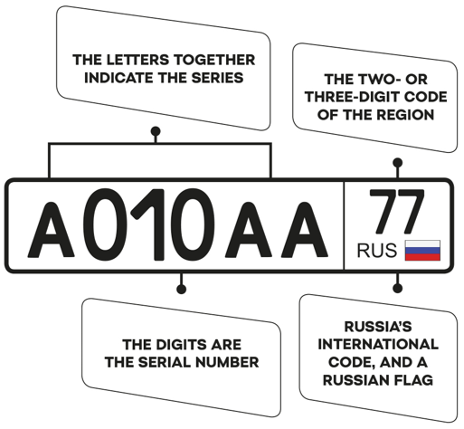
MOTIVATING EXAMPLE: LICENSE PLATES
Source: Skoda Storyboard
A Russian license plate:
3 letters + 3 digits + regional code
12 letters and 10 digits can be used.
How many combinations are there per region?
~ 1.7 million unique plates
Moscow has nine regional codes.
~ 1.7 million -> ~15.5 million unique plates.

Slide 20
MOTIVATING EXAMPLE: LICENSE PLATES
Source: Skoda Storyboard
A Russian license plate:
3 letters + 3 digits + regional code
12 letters and 10 digits can be used.
How many combinations are there per region?
~ 1.7 million unique plates
Moscow has nine regional codes.
~ 1.7 million -> ~15.5 million unique plates.

Slide 21
MOTIVATING EXAMPLE: LICENSE PLATES
Source: Skoda Storyboard
A Russian license plate:
3 letters + 3 digits + regional code
12 letters and 10 digits can be used.
How many combinations are there per region?
~ 1.7 million unique plates
Moscow has nine regional codes.
~ 1.7 million -> ~15.5 million unique plates.

Slide 22
MOTIVATING EXAMPLE: LICENSE PLATES
Source: Skoda Storyboard
A Russian license plate:
3 letters + 3 digits + regional code
12 letters and 10 digits can be used.
How many combinations are there per region?
~ 1.7 million unique plates
Moscow has nine regional codes.
~ 1.7 million -> ~15.5 million unique plates.

Slide 23
MOTIVATING EXAMPLE: LICENSE PLATES
Source: Skoda Storyboard
A Russian license plate:
3 letters + 3 digits + regional code
12 letters and 10 digits can be used.
How many combinations are there per region?
~ 1.7 million unique plates
Moscow has nine regional codes.
~ 1.7 million -> ~15.5 million unique plates.

Slide 24
MOTIVATING EXAMPLE: PHONE NUMBERS

Slide 25
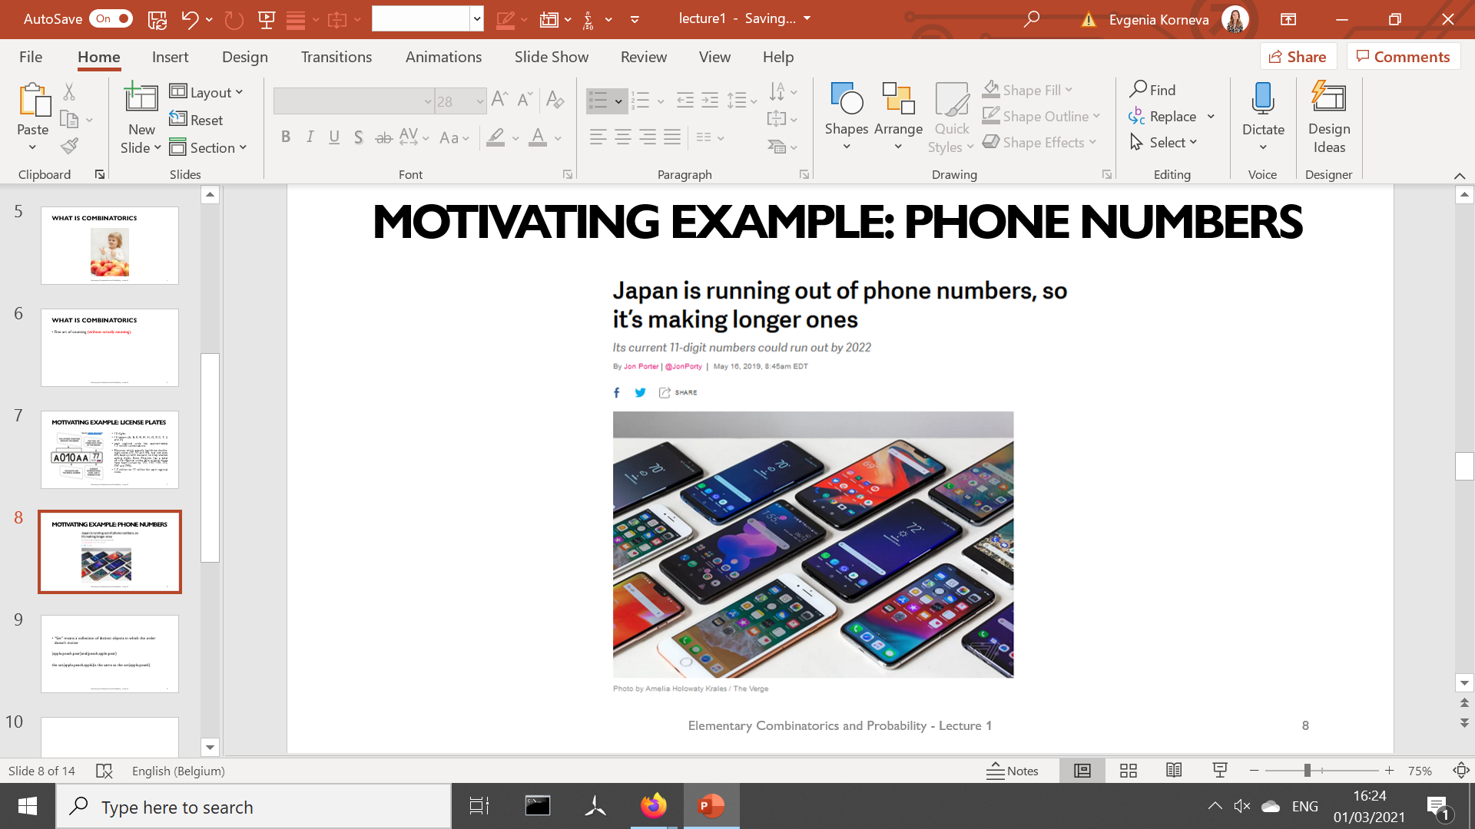
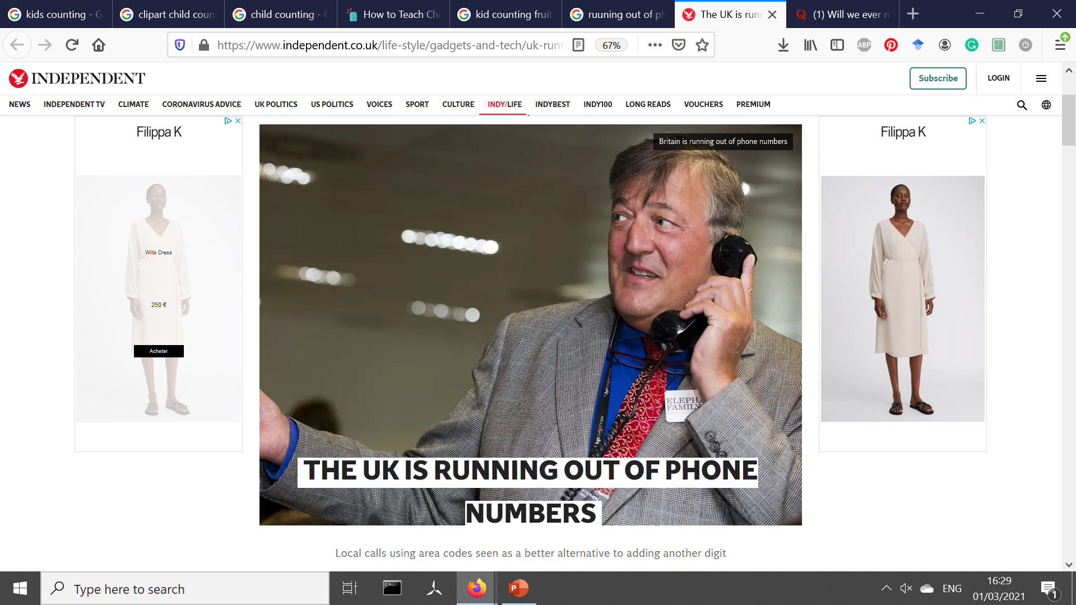
MOTIVATING EXAMPLE: PHONE NUMBERS
Source: Independent
Source: The Verge

Slide 26
What is combinatorics
We can easily count by enumeration:
But enumeration is not always easy.
Combinatorics = fine art of counting (without actually enumerating).
1 2 3 4 5 6 7 8 9 10

Slide 27
Combinatorics: What ELSE for?
Computer science: determining the time and storage required to solve a problem.
Basis of probability theory
we’ll see it later in the course.
Some proof techniques in mathematics rely on combinatorics.

Slide 28
Combinatorics: What ELSE for?
Computer science: determining the time and storage required to solve a problem.
Basis of probability theory
we’ll see it later in the course.
Some proof techniques in mathematics rely on combinatorics.

Slide 29
Combinatorics: What ELSE for?
Computer science: determining the time and storage required to solve a problem.
Basis of probability theory
we’ll see it later in the course.
Some proof techniques in mathematics rely on combinatorics.

Slide 30
Combinatorics: What ELSE for?
Computer science: determining the time and storage required to solve a problem.
Basis of probability theory
we’ll see it later in the course.
Some proof techniques in mathematics rely on combinatorics.

Slide 31
SET THEORY

Slide 32
SETS
We almost always have a collection of things we are trying to study.
Set is a collection of distinct objects in which the order doesn’t matter.

Slide 33
SETS
We almost always have a collection of things we are trying to study.
Set is a collection of distinct objects in which the order doesn’t matter.

Slide 34
SETS
Set is a collection of distinct objects in which the order doesn’t matter
{apple, peach} is a set
{apple, apple, peach} is not a set
{apple, peach, pear} is the same as {peach, apple, pear}

Slide 35
SETS
Set is a collection of distinct objects in which the order doesn’t matter
{apple, peach} is a set
{apple, apple, peach} is not a set
{apple, peach, pear} is the same as {peach, apple, pear}

Slide 36
SETS
Set is a collection of distinct objects in which the order doesn’t matter
{apple, peach} is a set
{apple, apple, peach} is not a set
{apple, peach, pear} is the same as {peach, apple, pear}

Slide 37
SETS
Set is a collection of distinct objects in which the order doesn’t matter
{apple, peach} is a set
{apple, apple, peach} is not a set
{apple, peach, pear} is the same as {peach, apple, pear}

Slide 38
SETS
Set is a collection of distinct objects in which the order doesn’t matter
{apple, peach} is a set
{apple, apple, peach} is not a set
{apple, peach, pear} is the same as {peach, apple, pear}

Slide 39

SOME basic NOTATION
A set A contains elements a, b and c: A = {a, b, c}
Element a is in the set A: a $∈$ A
Set B contains all even numbers:
B = {x | x = 2n, n = 0, 1, 2, …}
Element 5 doesn’t belong to set B: 5 $∉$ B

Slide 40
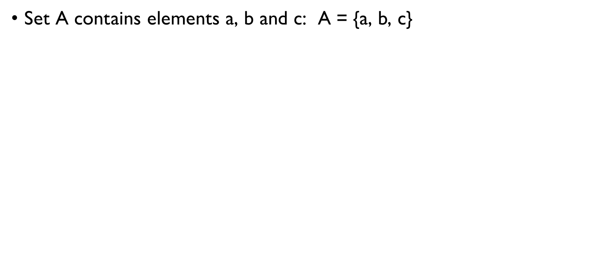
SOME basic NOTATION
Set A contains elements a, b and c: A = {a, b, c}
Element a is in the set A: a $∈$ A
Set B contains all even numbers:
B = {x | x = 2n, n = 0, 1, 2, …}
Element 5 doesn’t belong to set B: 5 $∉$ B

Slide 41
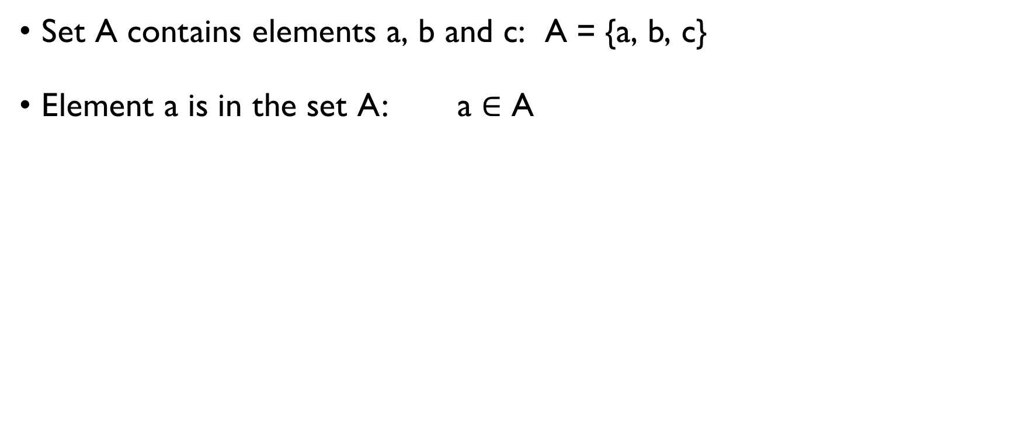
SOME basic NOTATION
Set A contains elements a, b and c: A = {a, b, c}
Element a is in the set A: a $∈$ A
Set B contains all even numbers:
B = {x | x = 2n, n = 0, 1, 2, …}
Element 5 doesn’t belong to set B: 5 $∉$ B

Slide 42
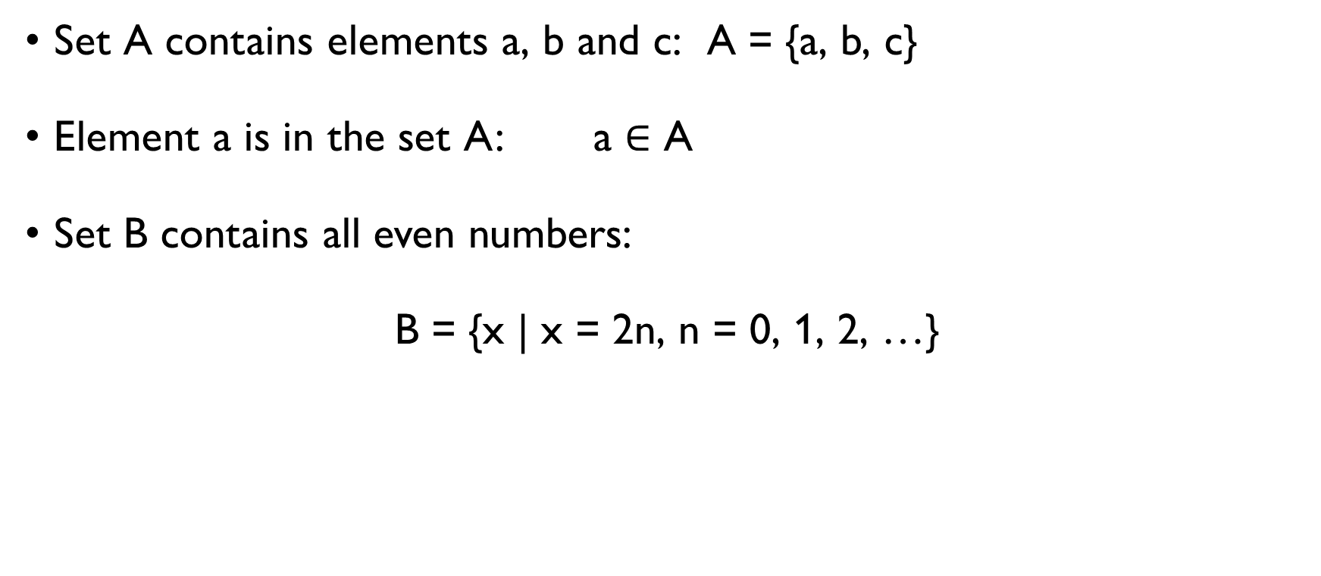
SOME basic NOTATION
Set A contains elements a, b and c: A = {a, b, c}
Element a is in the set A: a $∈$ A
Set B contains all even numbers:
B = {x | x = 2n, n = 0, 1, 2, …}
Element 5 doesn’t belong to set B: 5 $∉$ B

Slide 43
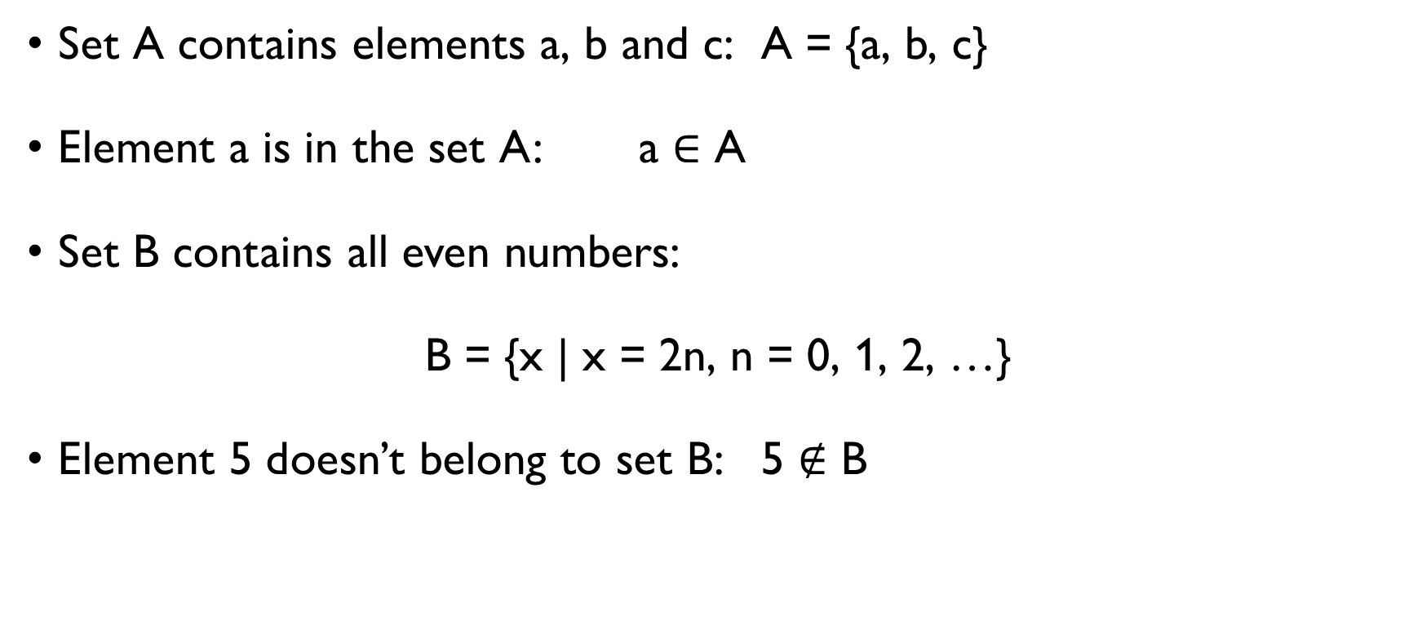
SOME basic NOTATION
Set A contains elements a, b and c: A = {a, b, c}
Element a is in the set A: a $∈$ A
Set B contains all even numbers:
B = {x | x = 2n, n = 0, 1, 2, …}
Element 5 doesn’t belong to set B: 5 $∉$ B

Slide 44
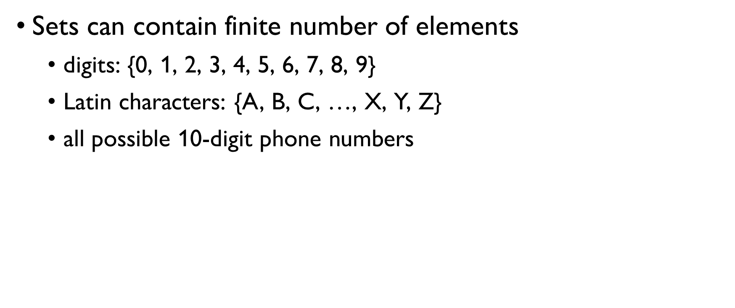
FINITE AND INFINITE SETS
Sets can contain finite number of elements
digits: {0, 1, 2, 3, 4, 5, 6, 7, 8, 9}
Latin characters: {A, B, C, …, X, Y, Z}
all possible 10-digit phone numbers
But sets can also be infinite:
natural numbers $ℕ$: {1, 2, 3, …}
integer numbers $ℤ$: {…, -2, -1, 0, 1, 2, …}

Slide 45
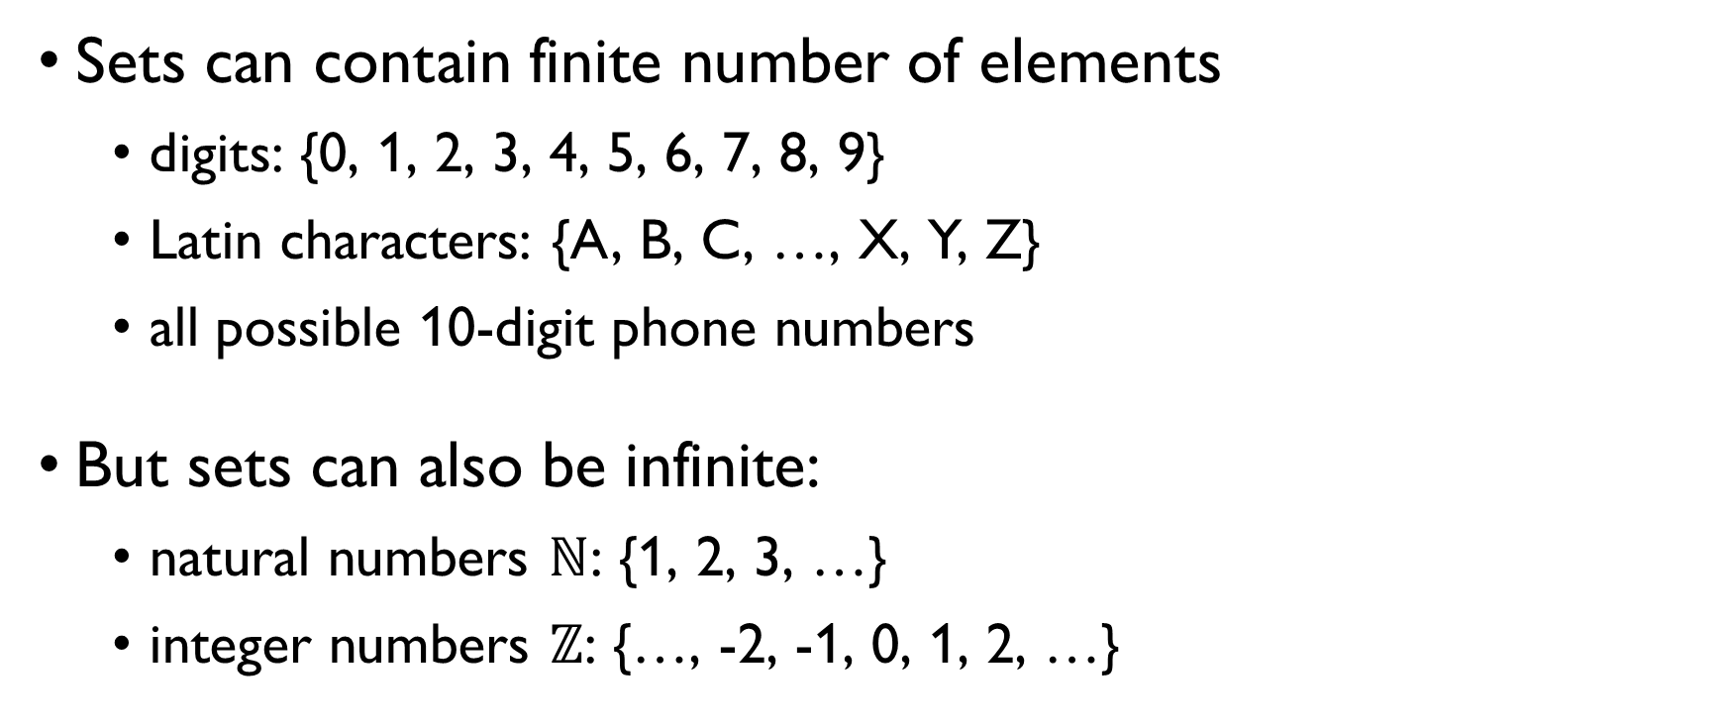
FINITE AND INFINITE SETS
Sets can contain finite number of elements
digits: {0, 1, 2, 3, 4, 5, 6, 7, 8, 9}
Latin characters: {A, B, C, …, X, Y, Z}
all possible 10-digit phone numbers
But sets can also be infinite:
natural numbers $ℕ$: {1, 2, 3, …}
integer numbers $ℤ$: {…, -2, -1, 0, 1, 2, …}

Slide 46

FINITE AND INFINITE SETS
Sets can contain finite number of elements
digits: {0, 1, 2, 3, 4, 5, 6, 7, 8, 9}
Latin characters: {A, B, C, …, X, Y, Z}
all possible 10-digit phone numbers
But sets can also be infinite:
natural numbers $ℕ$: {1, 2, 3, …}
integer numbers $ℤ$: {…, -2, -1, 0, 1, 2, …}

Slide 47
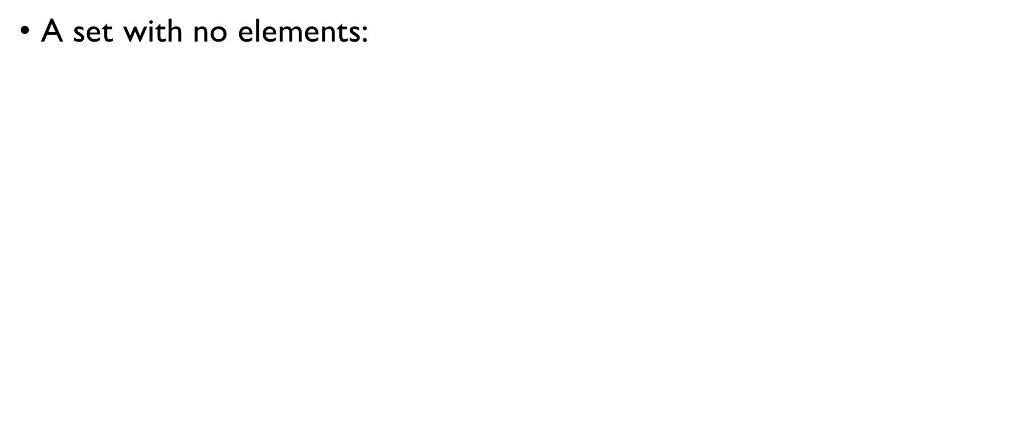
EMPTY SET
A set with no elements:
A = {}, A = $∅$

Slide 48
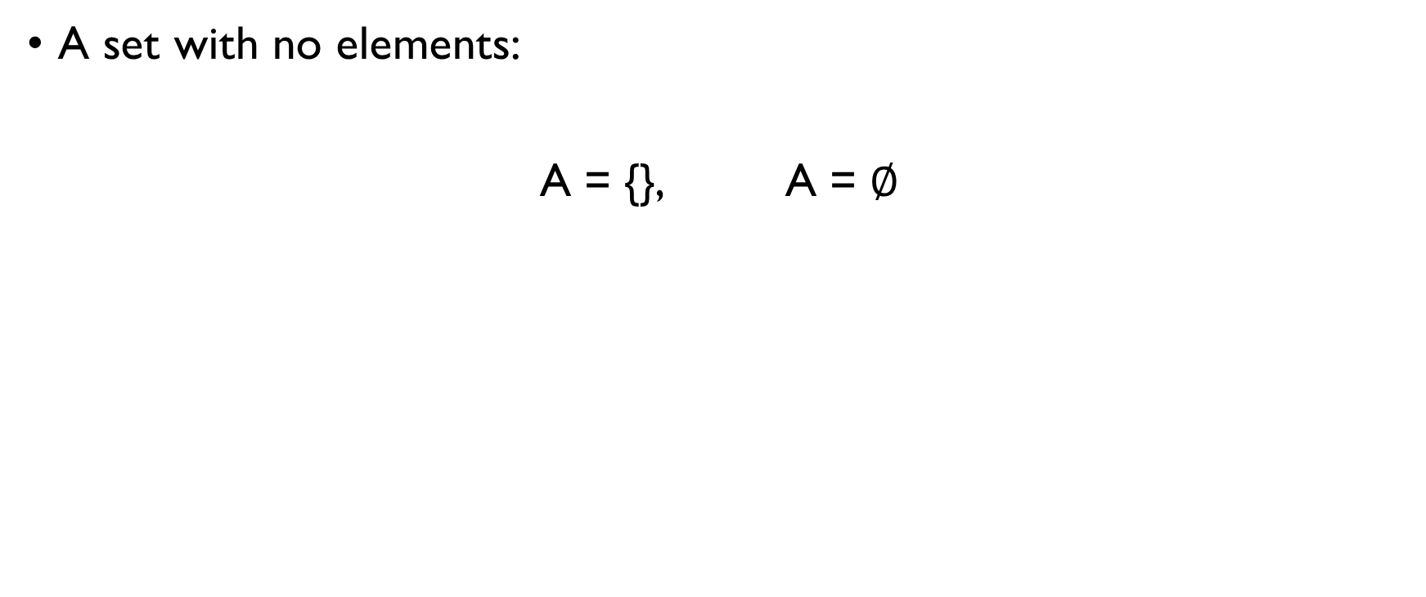
EMPTY SET
A set with no elements:
A = {}, A = $∅$

Slide 49
CARDINALITY OF A SET
Cardinality = “how large the set is”.
Finite sets: cardinality = number of elements.
A = {apple, banana, peach}, |A| = 3
B – a set of Latin characters, |B| = 26
C = {} – an empty set, |C| = 0

Slide 50
CARDINALITY OF A SET
Cardinality = “how large the set is”.
Finite sets: cardinality = number of elements.
A = {apple, banana, peach}, |A| = 3
B – a set of Latin characters, |B| = 26
C = {} – an empty set, |C| = 0

Slide 51
CARDINALITY OF A SET
Cardinality = “how large the set is”.
Finite sets: cardinality = number of elements.
A = {apple, banana, peach}, |A| = 3
B – a set of Latin characters, |B| = 26
C = {} – an empty set, |C| = 0

Slide 52
CARDINALITY OF A SET
Cardinality = “how large the set is”.
Finite sets: cardinality = number of elements.
A = {apple, banana, peach}, |A| = 3
B – a set of Latin characters, |B| = 26
C = {} – an empty set, |C| = 0

Slide 53
CARDINALITY OF A SET
Cardinality = “how large the set is”.
Finite sets: cardinality = number of elements.
A = {apple, banana, peach}, |A| = 3
B – a set of Latin characters, |B| = 26
C = {} – an empty set, |C| = 0

Slide 54
CARDINALITY OF A SET
Cardinality = “how large the set is”.
Finite sets: cardinality = number of elements.
A = {apple, banana, peach}, |A| = 3
B – a set of Latin characters, |B| = 26
C = {} – an empty set, |C| = 0

Slide 55
CARDINALITY OF A SET
Cardinality = “how large the set is”.
Finite sets: cardinality = number of elements.
A = {apple, banana, peach}, |A| = 3
B – a set of Latin characters, |B| = 26
C = {} – an empty set, |C| = 0

Slide 56
SUBSET OF A SET
If each element of a set A is also an element of a set B, we say that A is a subset of B:
A ⊆ B
Example: A – a set of all numbers between 0 and 100 divisible by 3. B – a set of all numbers between 0 and 100. A ⊆ B

Slide 57
SUBSET OF A SET
If each element of a set A is also an element of a set B, we say that A is a subset of B:
A ⊆ B
Example: A – a set of all numbers between 0 and 100 divisible by 3. B – a set of all numbers between 0 and 100. A ⊆ B

Slide 58
SUBSET OF A SET
If each element of a set A is also an element of a set B, we say that A is a subset of B:
A ⊆ B
Example: A – a set of all numbers between 0 and 100 divisible by 3. B – a set of all numbers between 0 and 100. A ⊆ B

Slide 59
SUBSET OF A SET
If each element of a set A is also an element of a set B, we say that A is a subset of B:
A ⊆ B
Example: A – a set of all numbers between 0 and 100 divisible by 3. B – a set of all numbers between 0 and 100. A ⊆ B

Slide 60
visualization
All numbers
Numbers divisible by 3

Slide 61
OPERATIONS WITH SETS

Slide 62
OPERATIONS ON SETS: UNION
The union of A and B is
A ∪ B = {x | x ∈ A or x ∈ B }
Example: A = {apple, banana} B = {orange, banana, peach} A ∪ B = {apple, banana, orange, peach}

Slide 63
OPERATIONS ON SETS: UNION
The union of A and B is
A ∪ B = {x | x ∈ A or x ∈ B }
Example: A = {apple, banana} B = {orange, banana, peach} A ∪ B = {apple, banana, orange, peach}

Slide 64
OPERATIONS ON SETS: UNION
The union of A and B is
A ∪ B = {x | x ∈ A or x ∈ B }
Example: A = {apple, banana} B = {orange, banana, peach} A ∪ B = {apple, banana, orange, peach}

Slide 65
OPERATIONS ON SETS: UNION
The union of A and B is
A ∪ B = {x | x ∈ A or x ∈ B }
Example: A = {apple, banana} B = {orange, banana, peach} A ∪ B = {apple, banana, orange, peach}

Slide 66
OPERATIONS ON SETS: INTERSECTION
The intersection of A and B is
A ∩ B = {x | x ∈ A and x ∈ B }
Example: A = {apple, banana} B = {orange, banana, peach} A ∩ B = {banana }

Slide 67
OPERATIONS ON SETS: INTERSECTION
The intersection of A and B is
A ∩ B = {x | x ∈ A and x ∈ B }
Example: A = {apple, banana} B = {orange, banana, peach} A ∩ B = {banana }

Slide 68
OPERATIONS ON SETS: INTERSECTION
The intersection of A and B is
A ∩ B = {x | x ∈ A and x ∈ B }
Example: A = {apple, banana} B = {orange, banana, peach} A ∩ B = {banana }

Slide 69
OPERATIONS ON SETS: INTERSECTION
The intersection of A and B is
A ∩ B = {x | x ∈ A and x ∈ B }
Example: A = {apple, banana} B = {orange, banana, peach} A ∩ B = {banana }

Slide 70
OPERATIONS ON SETS: INTERSECTION
The intersection of A and B is
A ∩ B = {x | x ∈ A and x ∈ B }
Example: A = {apple, banana} B = {orange, banana, peach} A ∩ B = {banana}

Slide 71
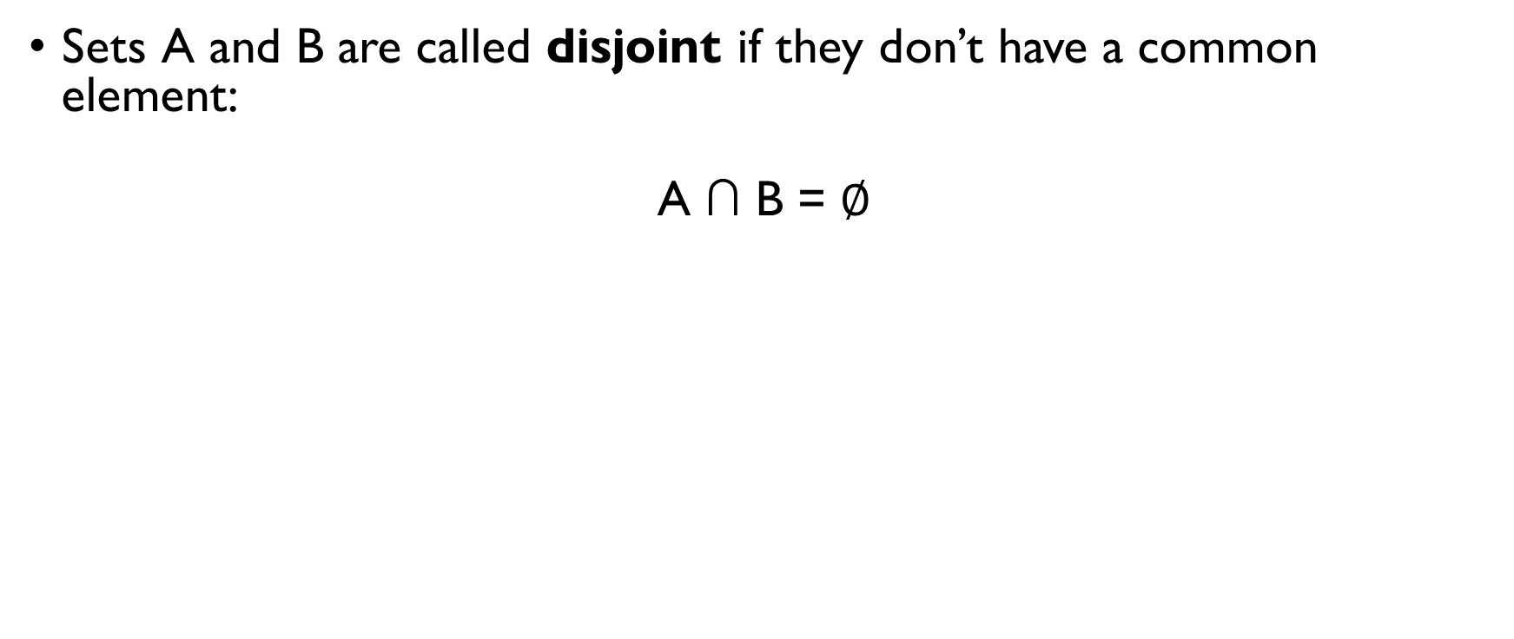
OPERATIONS ON SETS: INTERSECTION
Sets A and B are called disjoint if they don’t have a common element:
A ∩ B = $∅$
Example: A = {apple, banana} B = {orange, peach} A ∩ B = $∅$

Slide 72
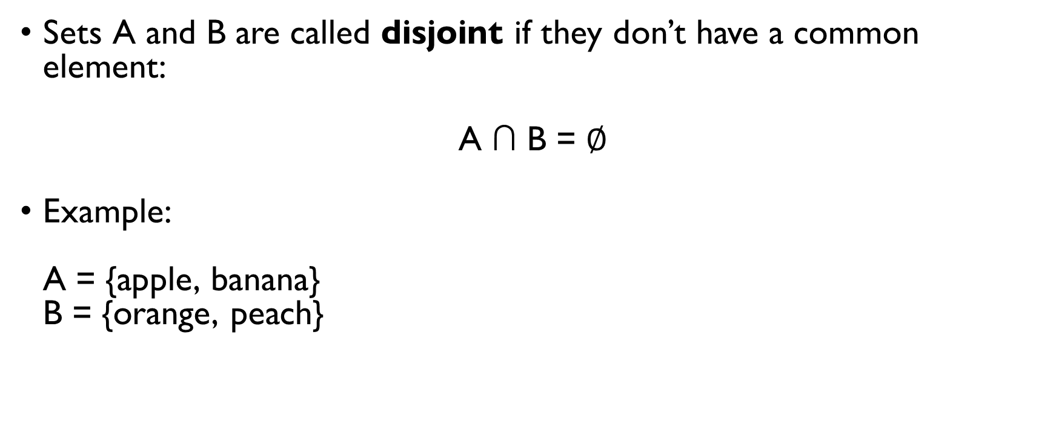
OPERATIONS ON SETS: INTERSECTION
Sets A and B are called disjoint if they don’t have a common element:
A ∩ B = $∅$
Example: A = {apple, banana} B = {orange, peach} A ∩ B = $∅$

Slide 73
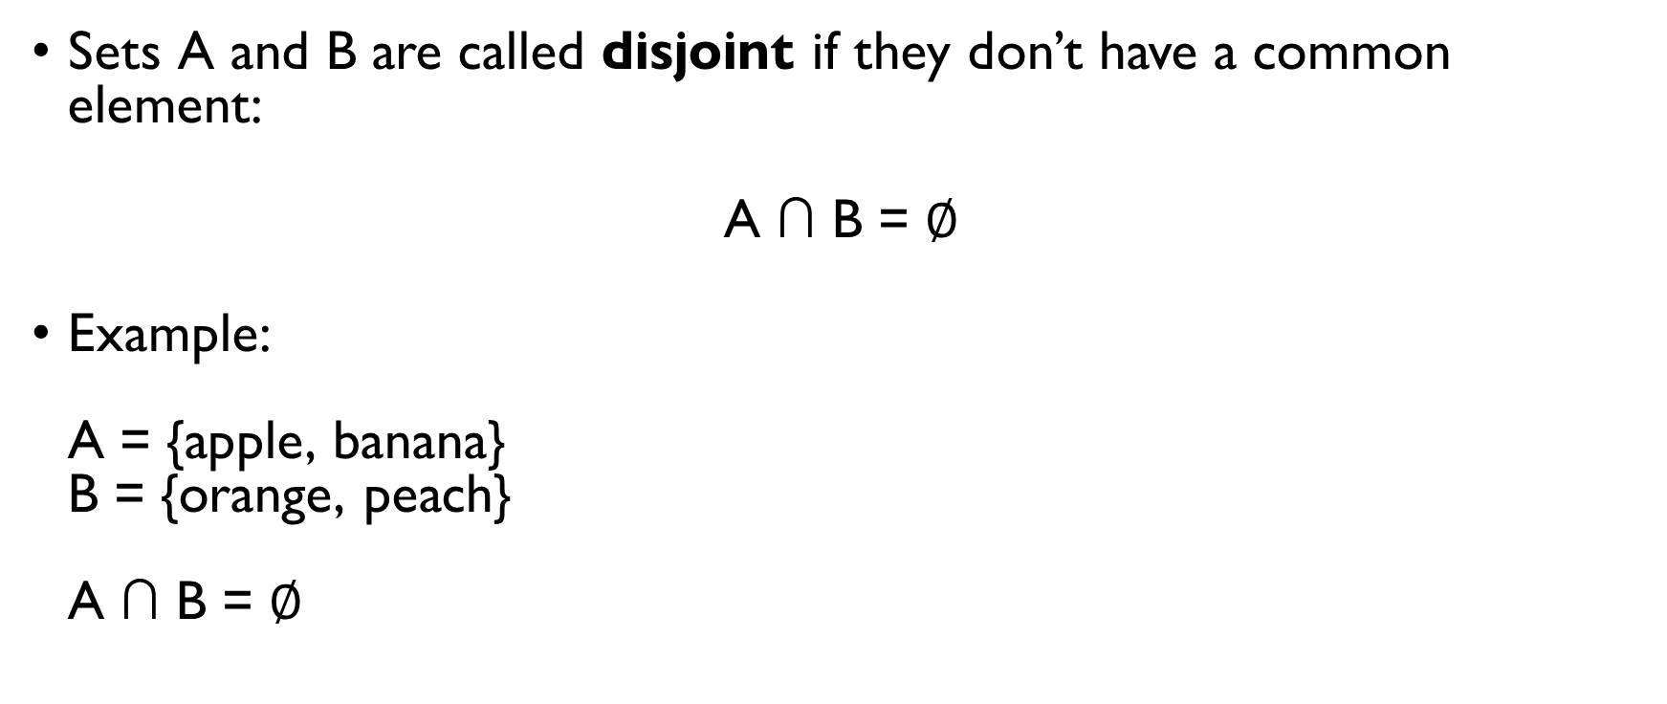
OPERATIONS ON SETS: INTERSECTION
Sets A and B are called disjoint if they don’t have a common element:
A ∩ B = $∅$
Example: A = {apple, banana} B = {orange, peach} A ∩ B = $∅$

Slide 74
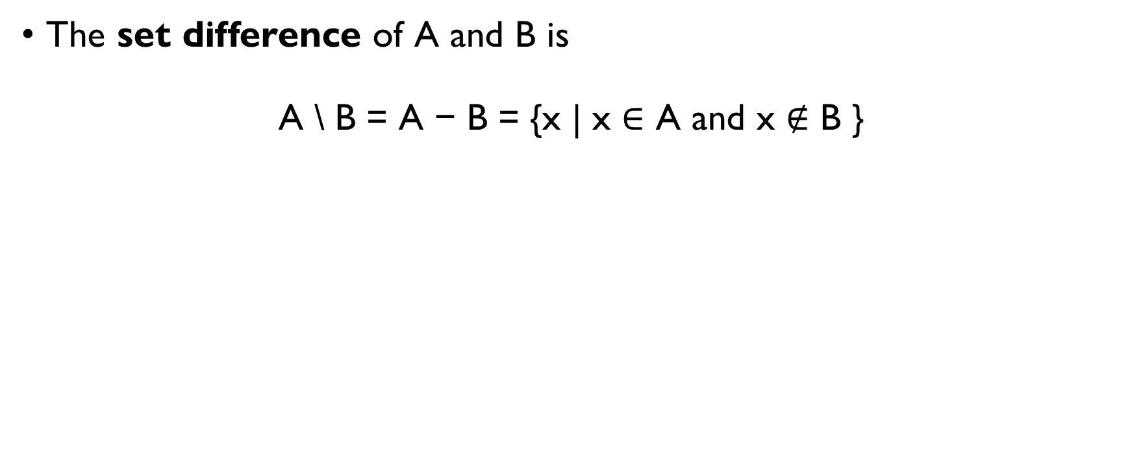
OPERATIONS ON SETS: DIFFERENCE
The set difference of A and B is
A \ B = A − B = {x | x ∈ A and x $∉$ B }
Example: A = {apple, banana} B = {orange, banana, peach} A \ B = {apple } B \ A = {orange, peach}

Slide 75
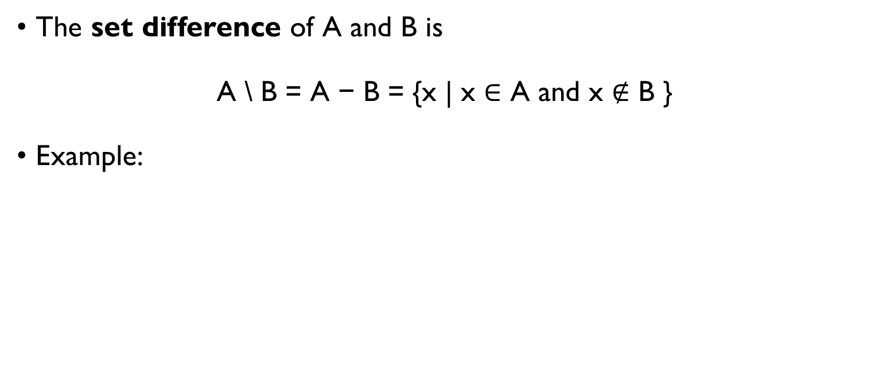
OPERATIONS ON SETS: DIFFERENCE
The set difference of A and B is
A \ B = A − B = {x | x ∈ A and x $∉$ B }
Example: A = {apple, banana} B = {orange, banana, peach} A \ B = {apple } B \ A = {orange, peach}

Slide 76
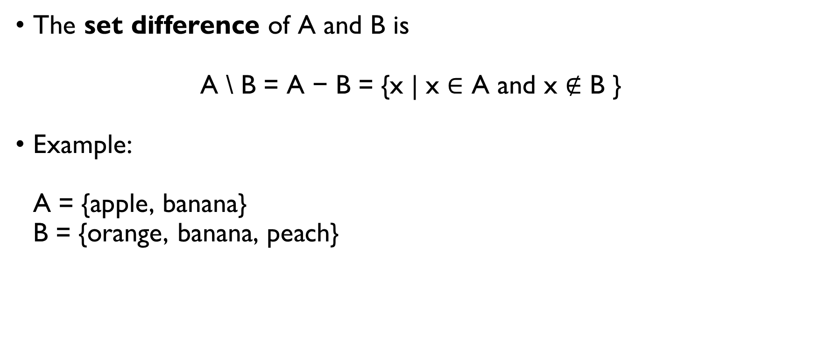
OPERATIONS ON SETS: DIFFERENCE
The set difference of A and B is
A \ B = A − B = {x | x ∈ A and x $∉$ B }
Example: A = {apple, banana} B = {orange, banana, peach} A \ B = {apple } B \ A = {orange, peach}

Slide 77
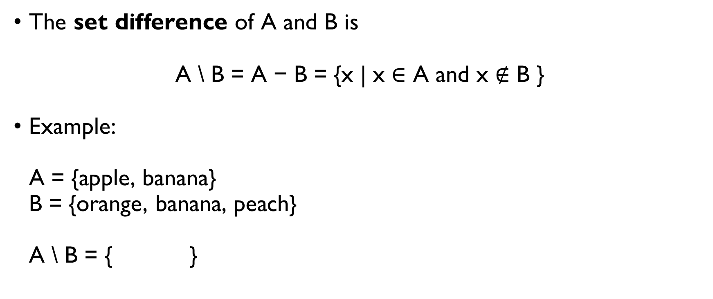
OPERATIONS ON SETS: DIFFERENCE
The set difference of A and B is
A \ B = A − B = {x | x ∈ A and x $∉$ B }
Example: A = {apple, banana} B = {orange, banana, peach} A \ B = {apple } B \ A = {orange, peach}

Slide 78
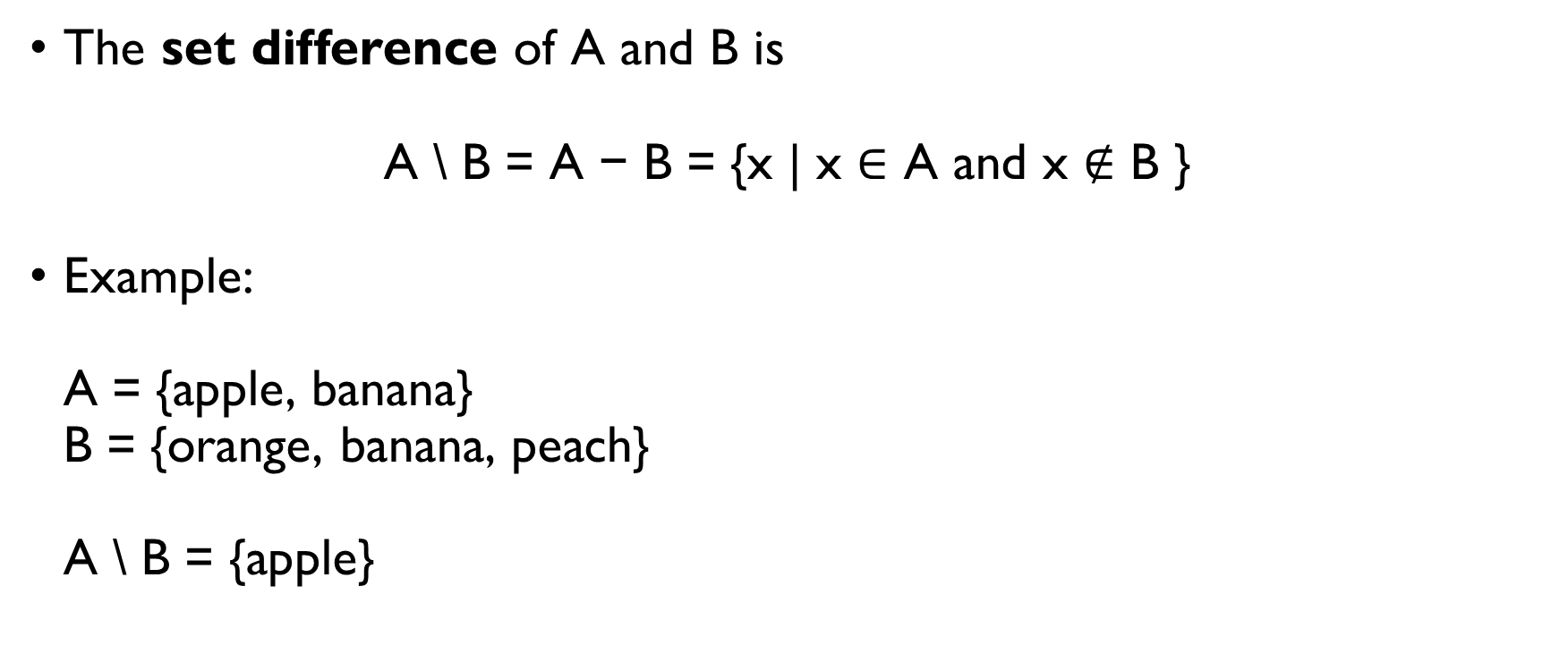
OPERATIONS ON SETS: DIFFERENCE
The set difference of A and B is
A \ B = A − B = {x | x ∈ A and x $∉$ B }
Example: A = {apple, banana} B = {orange, banana, peach} A \ B = {apple} B \ A = {orange, peach}

Slide 79
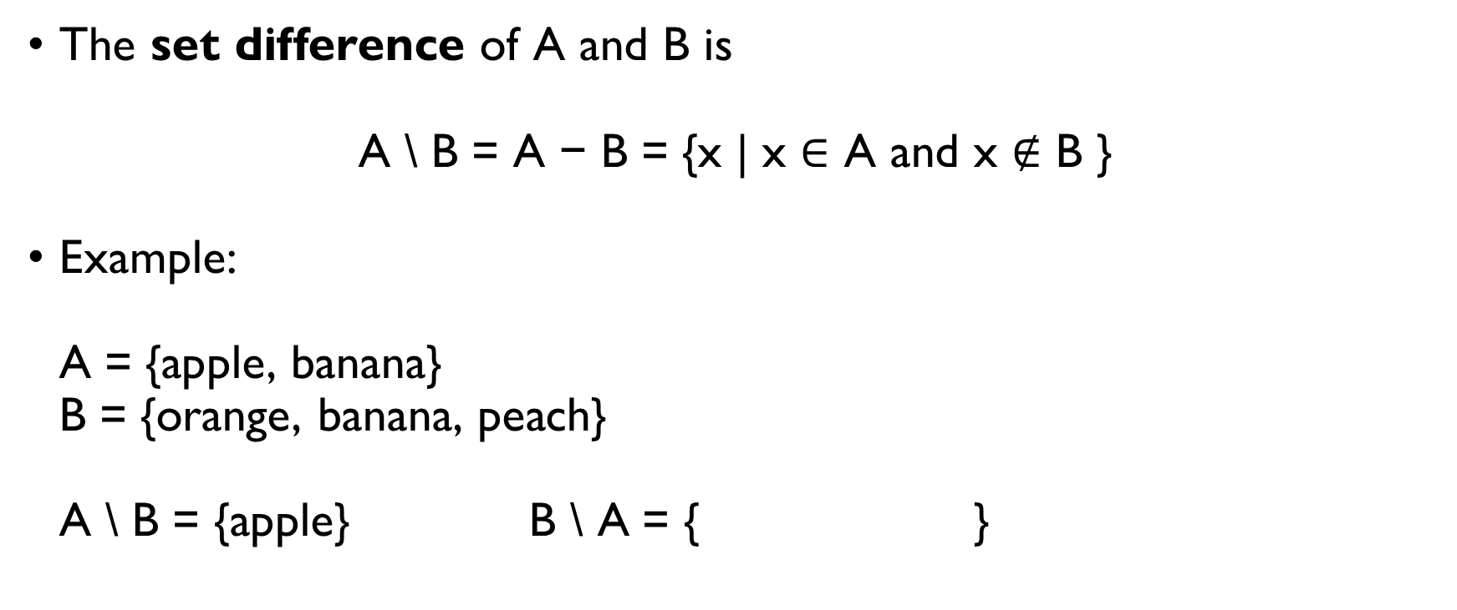
OPERATIONS ON SETS: DIFFERENCE
The set difference of A and B is
A \ B = A − B = {x | x ∈ A and x $∉$ B }
Example: A = {apple, banana} B = {orange, banana, peach} A \ B = {apple} B \ A = {orange, peach}

Slide 80
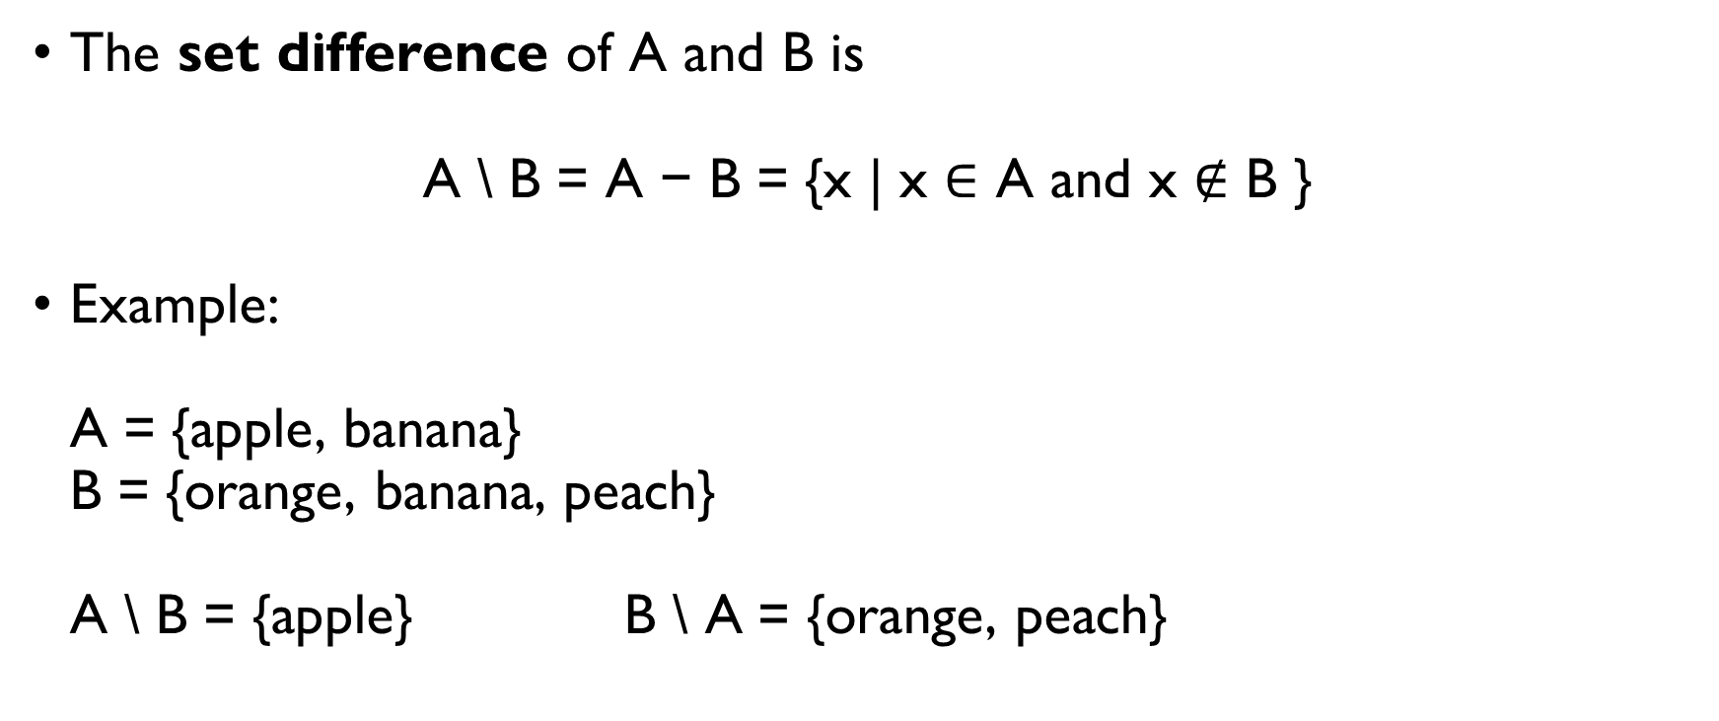
OPERATIONS ON SETS: DIFFERENCE
The set difference of A and B is
A \ B = A − B = {x | x ∈ A and x $∉$ B }
Example: A = {apple, banana} B = {orange, banana, peach} A \ B = {apple} B \ A = {orange, peach}

Slide 81
OPERATIONS with sets: Venn’s diagrams

Slide 82
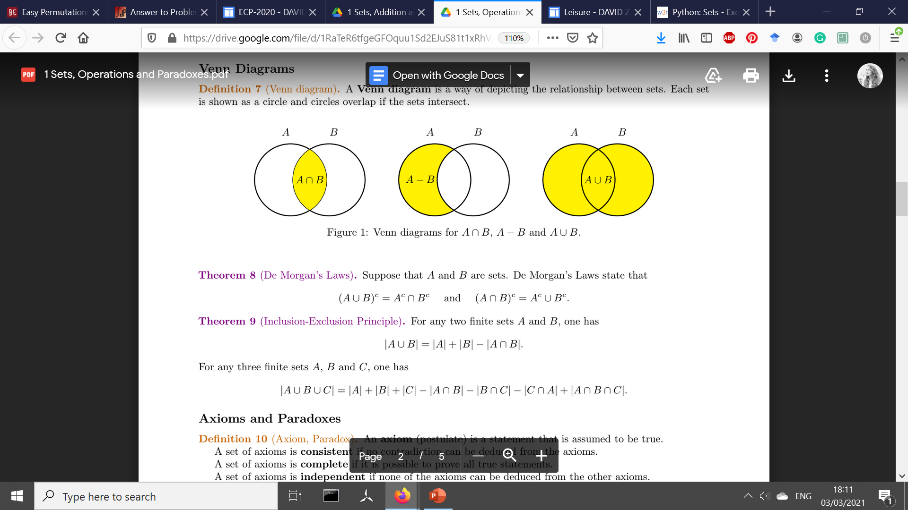
OPERATIONS with sets: Venn’s diagrams

Slide 83
OPERATIONS with sets: Venn’s diagrams

Slide 84
OPERATIONS with sets: Venn’s diagrams

Slide 85
OPERATIONS with sets: Venn’s diagrams

Slide 86
OPERATIONS with sets: Venn’s diagrams

Slide 87
OPERATIONS with sets: Venn’s diagrams

Slide 88
Absorption law
A ∩ (A ∪ B) = … ?

Slide 89
Absorption law
A ∩ (A ∪ B) = … ?

Slide 90
Absorption law
A ∩ (A ∪ B) = …?

Slide 91
Absorption law
A ∩ (A ∪ B) = A

Slide 92
Complement of a set
Let be U the universal set.
“a set of everything”, whatever that is in the given context.
Complement of A is
A^{c} = A = U \ A

Slide 93
Complement of a set
Let be U the universal set.
“a set of everything”, whatever that is in the given context.
Complement of A is
A^{c} = A = U \ A

Slide 94
Complement of a set: Example
A
Numbers between 1 and 100 divisible by 3

Slide 95
Complement of a set: Example
A
Numbers between 1 and 100 divisible by 3

Slide 96
Complement of a set: Example
U Numbers between 0 and 100
A
Numbers between 1 and 100 divisible by 3

Slide 97
Complement of a set: Example
U Numbers between 0 and 100
A
Numbers between 1 and 100 divisible by 3
A^{c} = ?

Slide 98
Complement of a set: Example
U Numbers between 0 and 100
A^{c}
A
Numbers between 1 and 100 divisible by 3

Slide 99
Complement of a set: Example
U Numbers between 0 and 100
A^{c}
A
Numbers between 1 and 100 divisible by 3
Numbers between 0 and 100 not divisible by 3

Slide 100
SHORT QUIZ
A ∪ ∅ = A
A ∩ ∅ = ∅
A ∪ U = U
A ∩ U = A

Slide 101
SHORT QUIZ
A ∪ ∅ = A
A ∩ ∅ = ∅
A ∪ U = U
A ∩ U = A

Slide 102
SHORT QUIZ
A ∪ ∅ = A
A ∩ ∅ = ∅
A ∪ U = U
A ∩ U = A

Slide 103
SHORT QUIZ
A ∪ ∅ = A
A ∩ ∅ = ∅
A ∪ U = U
A ∩ U = A

Slide 104
SHORT QUIZ
A ∪ ∅ = A
A ∩ ∅ = ∅
A ∪ U = U
A ∩ U = A

Slide 105
SHORT QUIZ
A ∪ ∅ = A
A ∩ ∅ = ∅
A ∪ U = U
A ∩ U = A

Slide 106
SHORT QUIZ
A ∪ ∅ = A
A ∩ ∅ = ∅
A ∪ U = U
A ∩ U = A

Slide 107
SHORT QUIZ
A ∪ ∅ = A
A ∩ ∅ = ∅
A ∪ U = U
A ∩ U = A

Slide 108
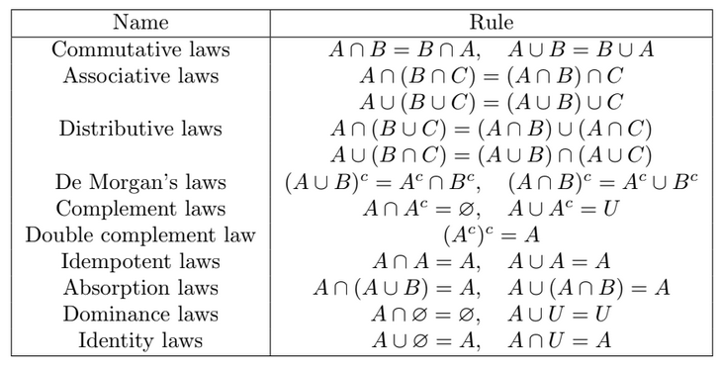
OTHER LAWS

Slide 109
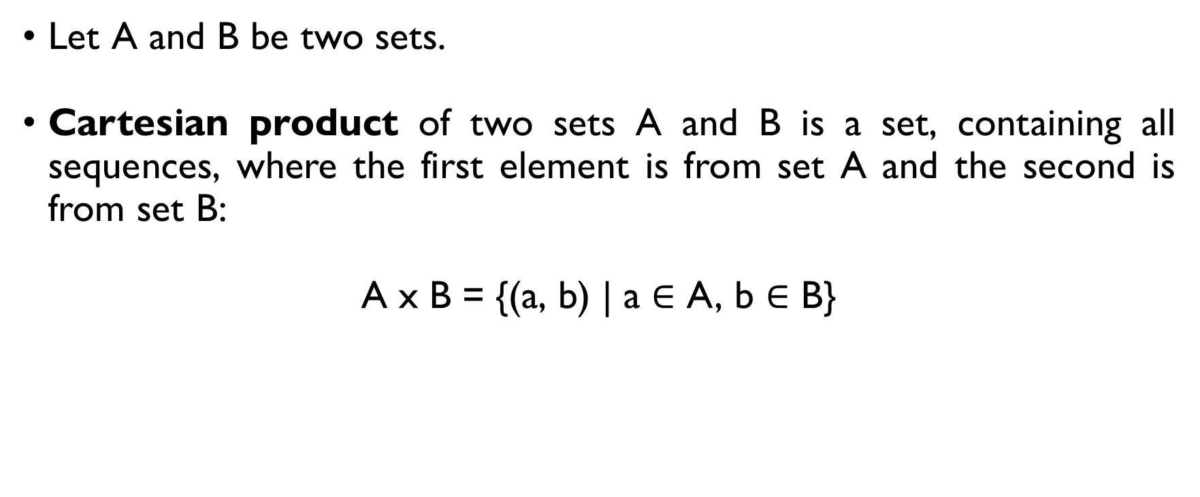
Cartesian product
Let A and B be two sets.
Cartesian product of two sets A and B is a set, containing all sequences, where the first element is from set A and the second is from set B:
A x B = {(a, b) | a $∈$ A, b $∈$ B}

Slide 110
Cartesian product: example
D = {wine, beer, water}
F = {spaghetti, burgers}
D x F = {(wine, spaghetti), (wine, burgers), (beer, spaghetti), (beer, burgers), (water, spaghetti), (water, burgers)}

Slide 111
Cartesian product: example
D = {wine, beer, water}
F = {spaghetti, burgers}
D x F = {(wine, spaghetti), (wine, burgers), (beer, spaghetti), (beer, burgers), (water, spaghetti), (water, burgers)}

Slide 112
Cartesian product: example
D = {wine, beer, water}
F = {spaghetti, burgers}
D x F = {(wine, spaghetti), (wine, burgers), (beer, spaghetti), (beer, burgers), (water, spaghetti), (water, burgers)}

Slide 113
Cartesian product: example
D = {wine, beer, water}
F = {spaghetti, burgers}
D x F = {(wine, spaghetti), (wine, burgers), (beer, spaghetti), (beer, burgers), (water, spaghetti), (water, burgers)}

Slide 114
Cartesian product: example
D = {wine, beer, water}
F = {spaghetti, burgers}
D x F = {(wine, spaghetti), (wine, burgers), (beer, spaghetti), (beer, burgers), (water, spaghetti), (water, burgers)}

Slide 115
BACK TO COUNTING…

Slide 116
ADDITION PRINCIPLE
(aka Rule of sum)

Slide 117
Rule of sum: EXAMPLE
We want to order dinner for tonight:
Pizza:
Dominos, Pizza Hut or King Slice (3 restaurants)
Sushi:
Wabi Sabi or Sakura (2 restaurants)
How many options are there?
3 pizza places + 2 sushi places = 3 + 2 = 5 options in total

Slide 118
Rule of sum: EXAMPLE
We want to order dinner for tonight:
Pizza:
Dominos, Pizza Hut or King Slice (3 restaurants)
Sushi:
Wabi Sabi or Sakura (2 restaurants)
How many options are there?
3 pizza places + 2 sushi places = 3 + 2 = 5 options in total

Slide 119
Rule of sum: EXAMPLE
We want to order dinner for tonight:
Pizza:
Dominos, Pizza Hut or King Slice (3 restaurants)
Sushi:
Wabi Sabi or Sakura (2 restaurants)
How many options are there?
3 pizza places + 2 sushi places = 3 + 2 = 5 options in total

Slide 120
Rule of sum: EXAMPLE
We want to order dinner for tonight:
Pizza:
Dominos, Pizza Hut or King Slice (3 restaurants)
Sushi:
Wabi Sabi or Sakura (2 restaurants)
How many options are there in total?
3 pizza places + 2 sushi places = 3 + 2 = 5 options in total

Slide 121
Rule of sum: EXAMPLE
We want to order dinner for tonight:
Pizza:
Dominos, Pizza Hut or King Slice (3 restaurants)
Sushi:
Wabi Sabi or Sakura (2 restaurants)
How many options are there in total?
3 pizza places + 2 sushi places = 3 + 2 = 5 options in total

Slide 122
Rule of sum: EXAMPLE
We want to order dinner for tonight:
Pizza:
Dominos, Pizza Hut or King Slice (3 restaurants)
Sushi:
Wabi Sabi or Sakura (2 restaurants)
How many options are there in total?
3 pizza places + 2 sushi places = 3 + 2 = 5 options in total

Slide 123
Rule of sum
If there are a ways of doing something and b number of ways of doing another thing and we can not do both at the same time, then there are a + b ways to choose one of the actions.

Slide 124
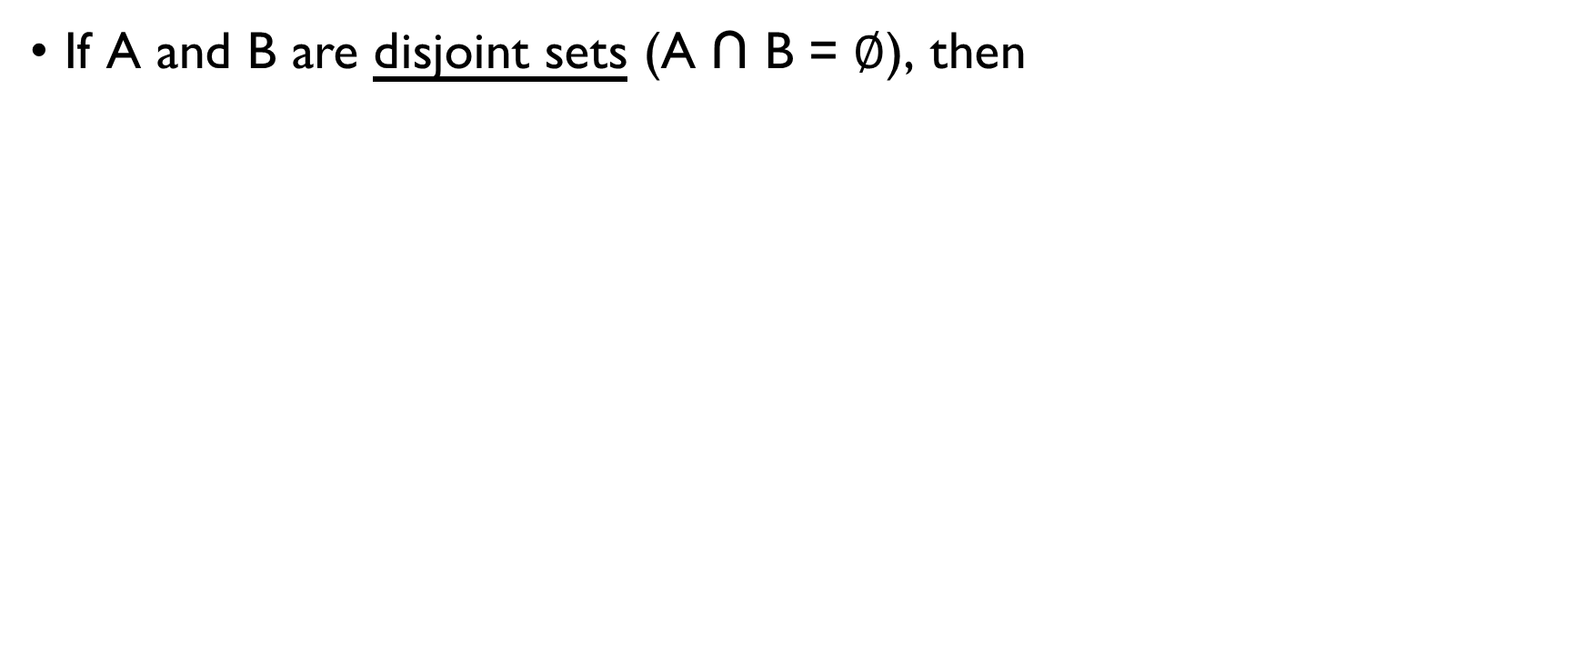
RULE OF SUM (SET THEORY)
If A and B are disjoint sets (A ∩ B = $∅$), then
|A ∪ B | = |A| + |B|
Generalized rule of sum: If A₁ ∩ A₂ ∩ … ∩ A_{n} = $∅$, then
| A₁ ∪ A₂ ∪ … ∪ A_{n}| = | A₁ | + | A₂ | + … + | A_{n} |

Slide 125
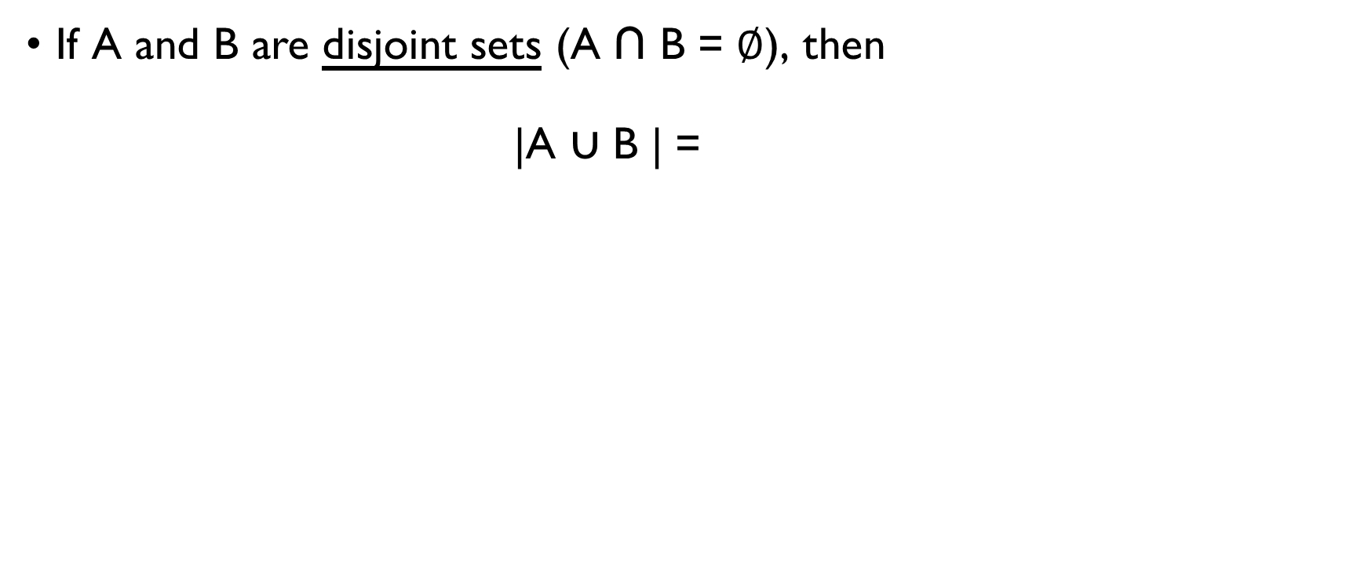
RULE OF SUM (SET THEORY)
If A and B are disjoint sets (A ∩ B = $∅$), then
|A ∪ B | = |A| + |B|
Generalized rule of sum: If A₁ ∩ A₂ ∩ … ∩ A_{n} = $∅$, then
| A₁ ∪ A₂ ∪ … ∪ A_{n}| = | A₁ | + | A₂ | + … + | A_{n} |

Slide 126
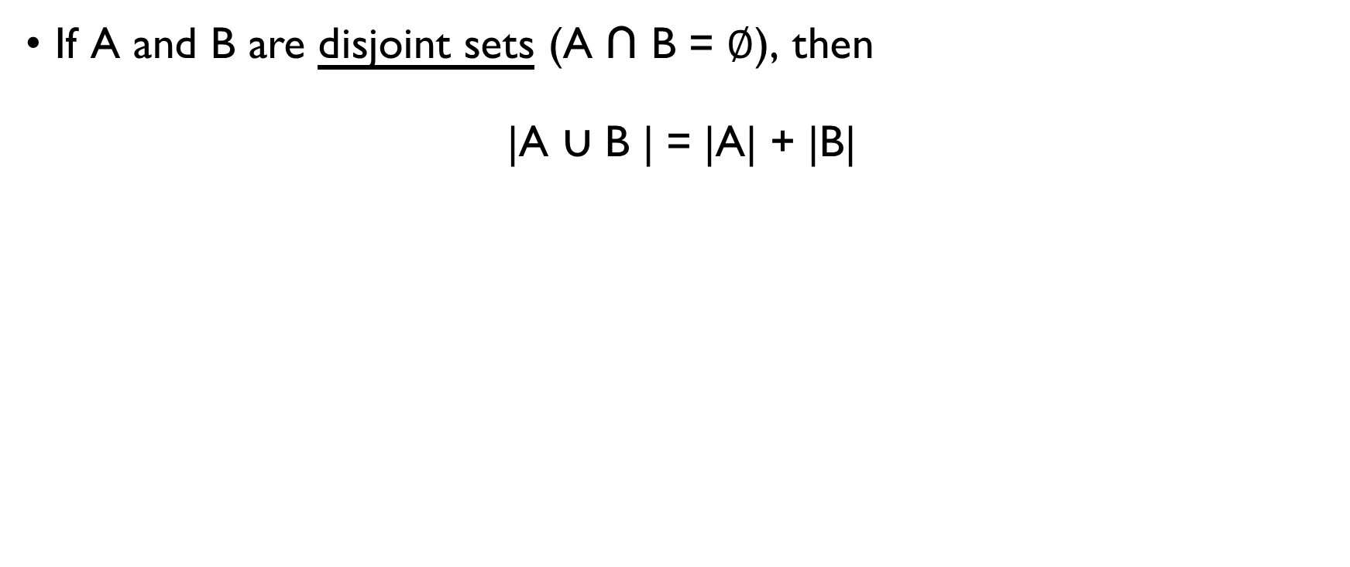
RULE OF SUM (SET THEORY)
If A and B are disjoint sets (A ∩ B = $∅$), then
|A ∪ B | = |A| + |B|
Generalized rule of sum: If A₁ ∩ A₂ ∩ … ∩ A_{n} = $∅$, then
| A₁ ∪ A₂ ∪ … ∪ A_{n}| = | A₁ | + | A₂ | + … + | A_{n} |

Slide 127
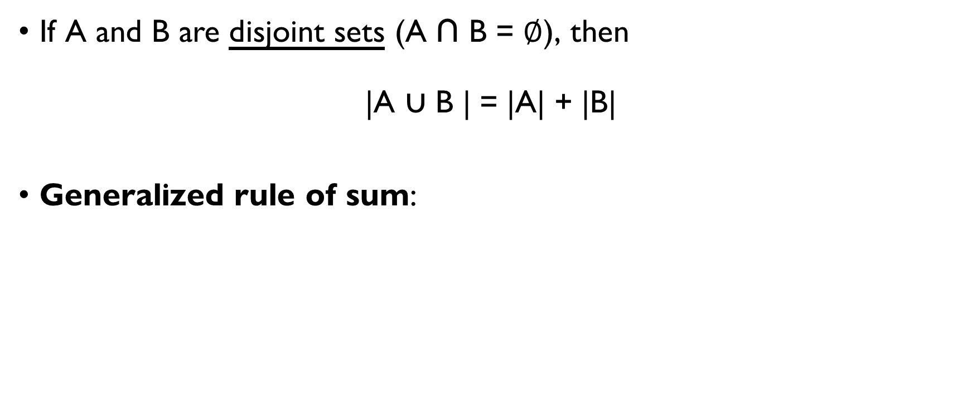
RULE OF SUM (SET THEORY)
If A and B are disjoint sets (A ∩ B = $∅$), then
|A ∪ B | = |A| + |B|
Generalized rule of sum: If A₁ ∩ A₂ ∩ … ∩ A_{n} = $∅$, then
| A₁ ∪ A₂ ∪ … ∪ A_{n}| = | A₁ | + | A₂ | + … + | A_{n} |

Slide 128
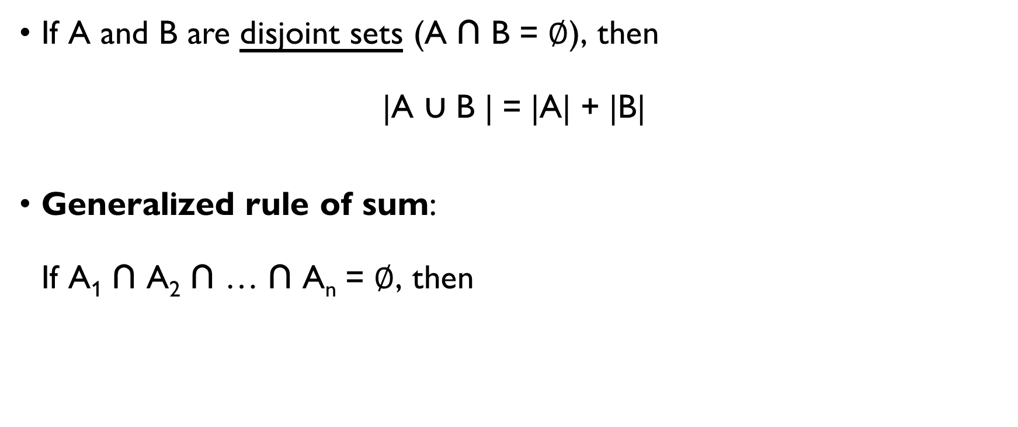
RULE OF SUM (SET THEORY)
If A and B are disjoint sets (A ∩ B = $∅$), then
|A ∪ B | = |A| + |B|
Generalized rule of sum: If A₁ ∩ A₂ ∩ … ∩ A_{n} = $∅$, then
| A₁ ∪ A₂ ∪ … ∪ A_{n}| = | A₁ | + | A₂ | + … + | A_{n} |

Slide 129
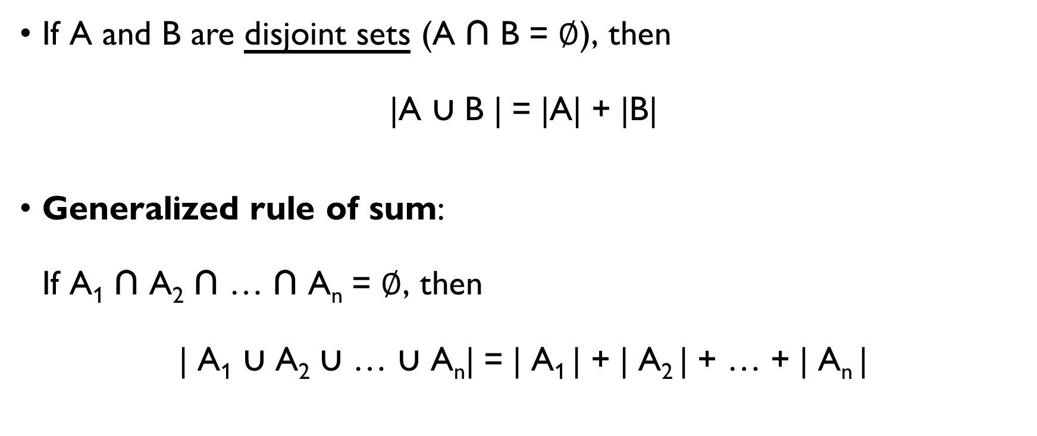
RULE OF SUM (SET THEORY)
If A and B are disjoint sets (A ∩ B = $∅$), then
|A ∪ B | = |A| + |B|
Generalized rule of sum: If A₁ ∩ A₂ ∩ … ∩ A_{n} = $∅$, then
| A₁ ∪ A₂ ∪ … ∪ A_{n}| = | A₁ | + | A₂ | + … + | A_{n} |

Slide 130
MULTIPLICATION PRINCIPLE
(aka Rule of product)

Slide 131
RULE OF PRODUCT informally
If there are a ways of doing something and b ways of doing another thing, then there are a · b ways of performing both actions.

Slide 132
RULE OF PRODUCT: EXAMPLE 1
You want to order pizza:
first, choose the type of crust:
thin or thick (2 choices);
second, choose one topping:
cheese, pepperoni, or sausage (3 choices).
How many different pizzas are there?
2 ways of choosing crust x 3 ways of choosing topping =
= 2 x 3 = 6 different pizzas

Slide 133
RULE OF PRODUCT: EXAMPLE 1
You want to order pizza:
first, choose the type of crust:
thin or thick (2 choices);
second, choose one topping:
cheese, pepperoni, or sausage (3 choices).
How many different pizzas are there?
2 ways of choosing crust x 3 ways of choosing topping =
= 2 x 3 = 6 different pizzas

Slide 134
RULE OF PRODUCT: EXAMPLE 1
You want to order pizza:
first, choose the type of crust:
thin or thick (2 choices);
second, choose one topping:
cheese, pepperoni, or sausage (3 choices).
How many different pizzas are there?
2 ways of choosing crust x 3 ways of choosing topping =
= 2 x 3 = 6 different pizzas

Slide 135
RULE OF PRODUCT: EXAMPLE 1
You want to order pizza:
first, choose the type of crust:
thin or thick (2 choices);
second, choose one topping:
cheese, pepperoni, or sausage (3 choices).
How many different pizzas are there?
2 ways of choosing crust x 3 ways of choosing topping =
= 2 x 3 = 6 different pizzas

Slide 136
RULE OF PRODUCT: EXAMPLE 1
You want to order pizza:
first, choose the type of crust:
thin or thick (2 choices);
second, choose one topping:
cheese, pepperoni, or sausage (3 choices).
How many different pizzas are there?
2 ways of choosing crust x 3 ways of choosing topping =
= 2 x 3 = 6 different pizzas

Slide 137
RULE OF PRODUCT: EXAMPLE 1
You want to order pizza:
first, choose the type of crust:
thin or thick (2 choices);
second, choose one topping:
cheese, pepperoni, or sausage (3 choices).
How many different pizzas are there?
2 ways of choosing crust x 3 ways of choosing topping =
= 2 x 3 = 6 different pizzas

Slide 138
RULE OF PRODUCT: EXAMPLE 1
PIZZA

Slide 139
RULE OF PRODUCT: EXAMPLE 1
PIZZA
THIN
THICK

Slide 140
RULE OF PRODUCT: EXAMPLE 1
PIZZA
THIN
THICK
THIN
CHEESE
THIN
PAPPERONI
THIN
SAUSAGE

Slide 141
RULE OF PRODUCT: EXAMPLE 1
PIZZA
THIN
THICK
THIN
CHEESE
THIN
PAPPERONI
THIN
SAUSAGE
THCK
CHEESE
THICK
PAPPERONI
THICK
SAUSAGE

Slide 142

Rule of product (set theory)
For any two sets A and B
|A x B| = |A| $⋅$ |B|
Generalized product rule: For any sets A_{1,} A₂, …, A_{n}
| A₁ x A₂ x … x A_{n} | = | A₁ | $⋅$ | A₂ | $⋅$ … $⋅$ | A_{n} |

Slide 143
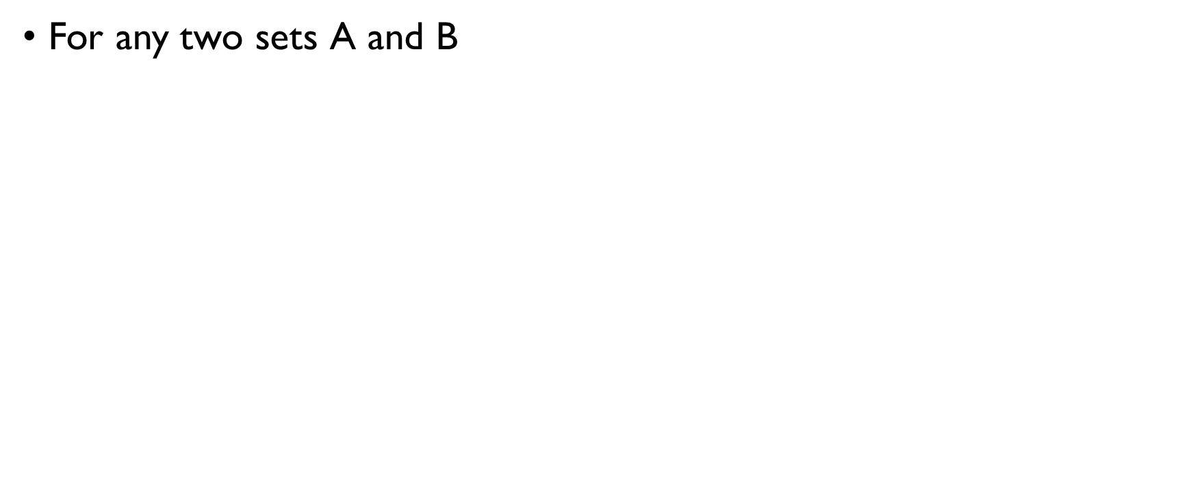
Rule of product (set theory)
For any two sets A and B
|A x B| = |A| $⋅$ |B|
Generalized product rule: For any sets A_{1,} A₂, …, A_{n}
| A₁ x A₂ x … x A_{n} | = | A₁ | $⋅$ | A₂ | $⋅$ … $⋅$ | A_{n} |

Slide 144
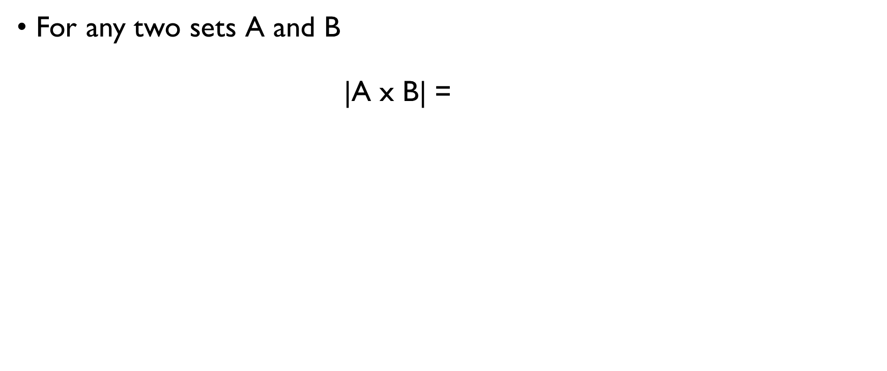
Rule of product (set theory)
For any two sets A and B
|A x B| = |A| $⋅$ |B|
Generalized product rule: For any sets A_{1,} A₂, …, A_{n}
| A₁ x A₂ x … x A_{n} | = | A₁ | $⋅$ | A₂ | $⋅$ … $⋅$ | A_{n} |

Slide 145
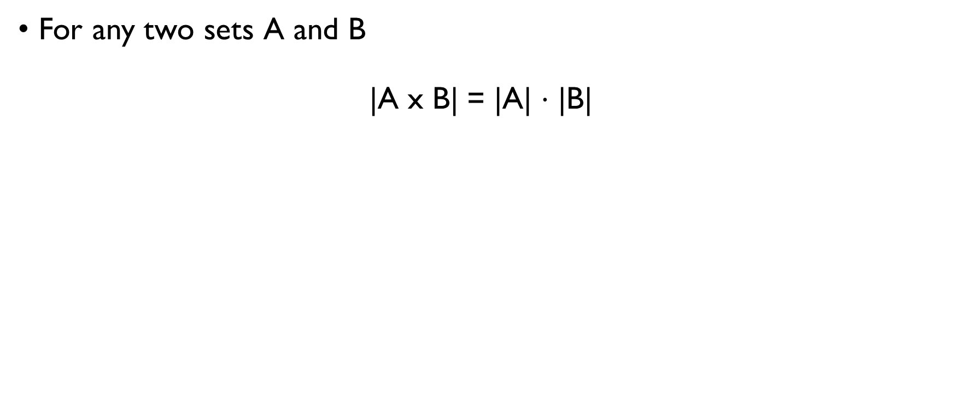
Rule of product (set theory)
For any two sets A and B
|A x B| = |A| $⋅$ |B|
Generalized product rule: For any sets A_{1,} A₂, …, A_{n}
| A₁ x A₂ x … x A_{n} | = | A₁ | $⋅$ | A₂ | $⋅$ … $⋅$ | A_{n} |

Slide 146
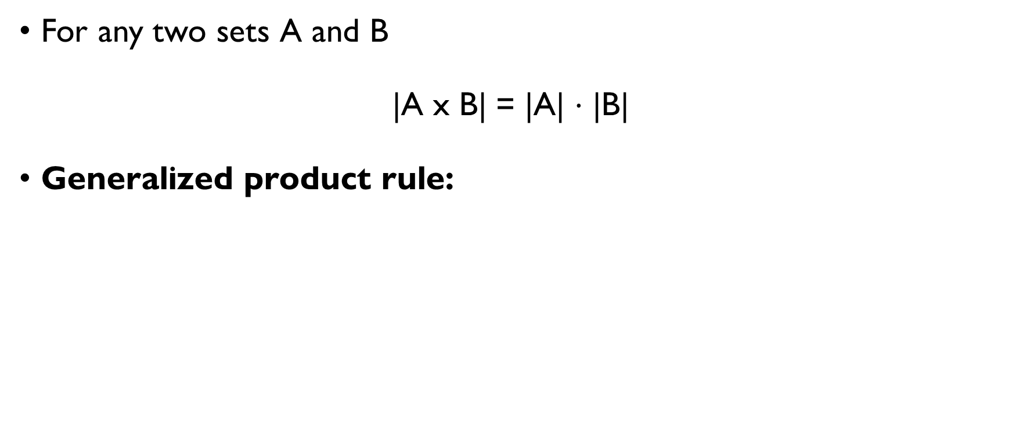
Rule of product (set theory)
For any two sets A and B
|A x B| = |A| $⋅$ |B|
Generalized product rule: For any sets A_{1,} A₂, …, A_{n}
| A₁ x A₂ x … x A_{n} | = | A₁ | $⋅$ | A₂ | $⋅$ … $⋅$ | A_{n} |

Slide 147
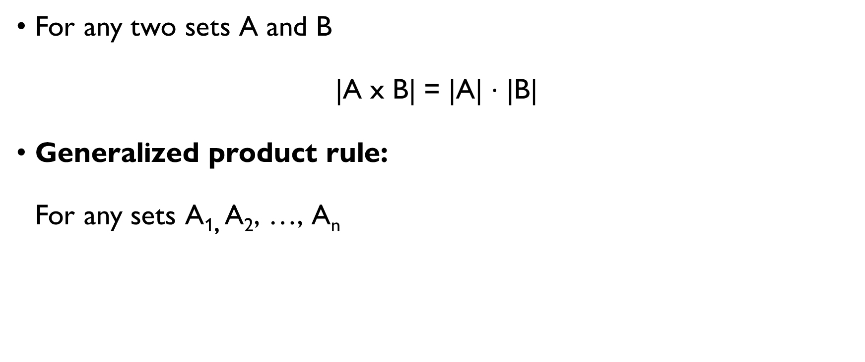
Rule of product (set theory)
For any two sets A and B
|A x B| = |A| $⋅$ |B|
Generalized product rule: For any sets A_{1,} A₂, …, A_{n}
| A₁ x A₂ x … x A_{n} | = | A₁ | $⋅$ | A₂ | $⋅$ … $⋅$ | A_{n} |

Slide 148
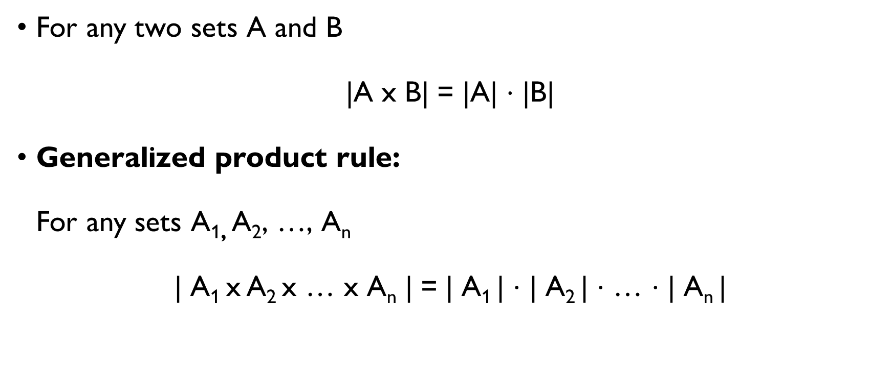
Rule of product (set theory)
For any two sets A and B
|A x B| = |A| $⋅$ |B|
Generalized product rule: For any sets A_{1,} A₂, …, A_{n}
| A₁ x A₂ x … x A_{n} | = | A₁ | $⋅$ | A₂ | $⋅$ … $⋅$ | A_{n} |

Slide 149
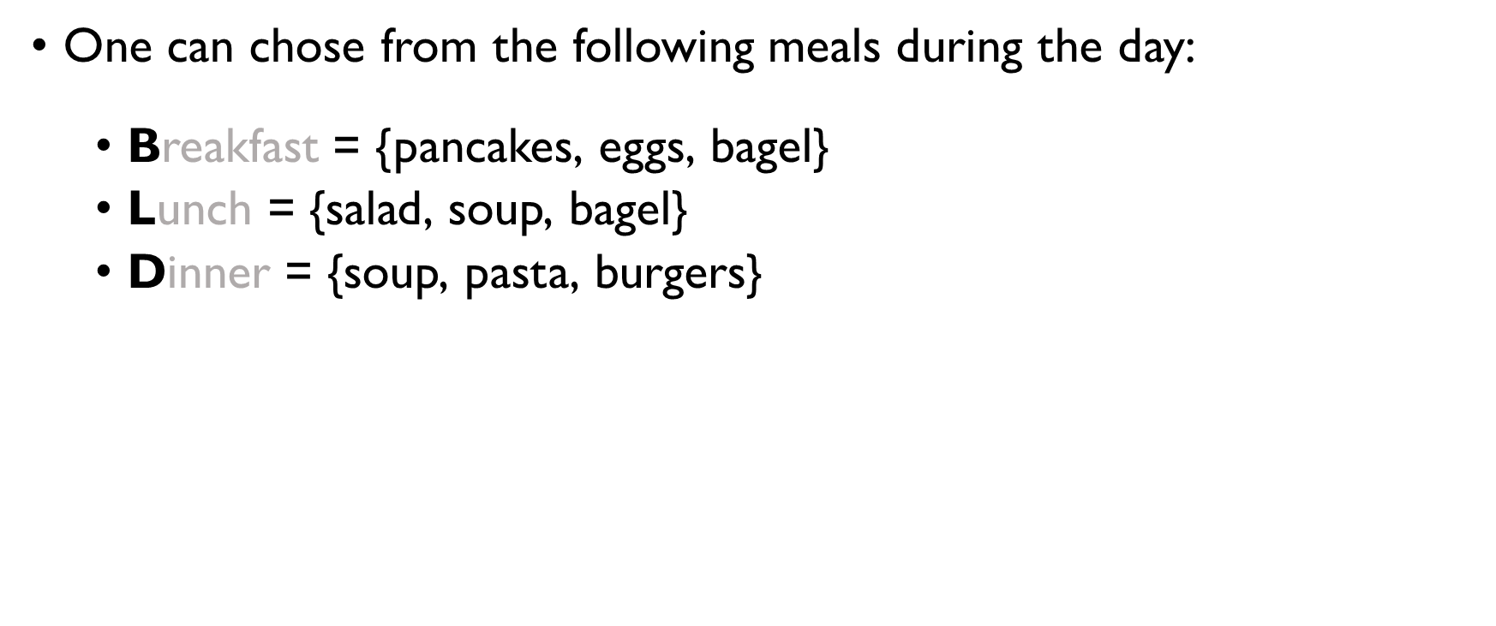
RULE OF PRODUCT: EXAMPLE 2
One can chose from the following meals during the day:
Breakfast = {pancakes, eggs, bagel}
Lunch = {salad, soup, bagel}
Dinner = {soup, pasta, burgers}
How many different day menus can one have?
|B| $⋅$ |L| $⋅$ |D| = 3 $⋅$ 3 $⋅$ 3 = 27

Slide 150
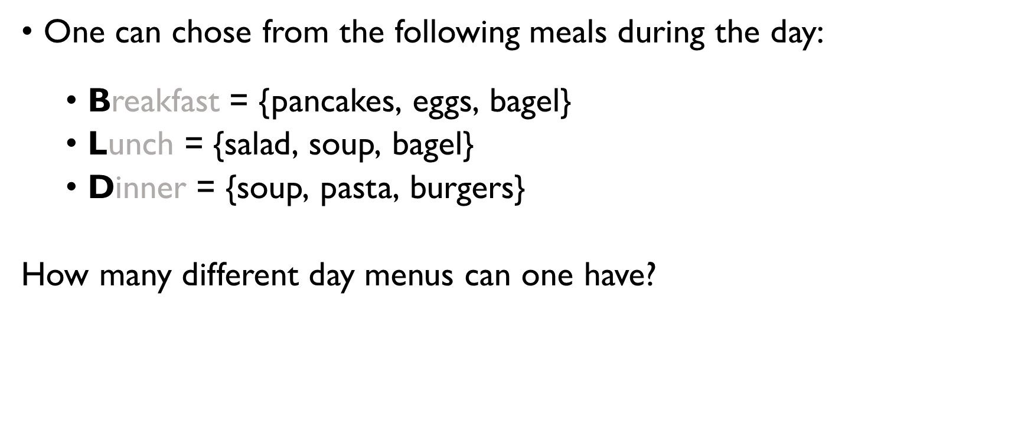
RULE OF PRODUCT: EXAMPLE 2
One can chose from the following meals during the day:
Breakfast = {pancakes, eggs, bagel}
Lunch = {salad, soup, bagel}
Dinner = {soup, pasta, burgers}
How many different day menus can one have?
|B| $⋅$ |L| $⋅$ |D| = 3 $⋅$ 3 $⋅$ 3 = 27

Slide 151
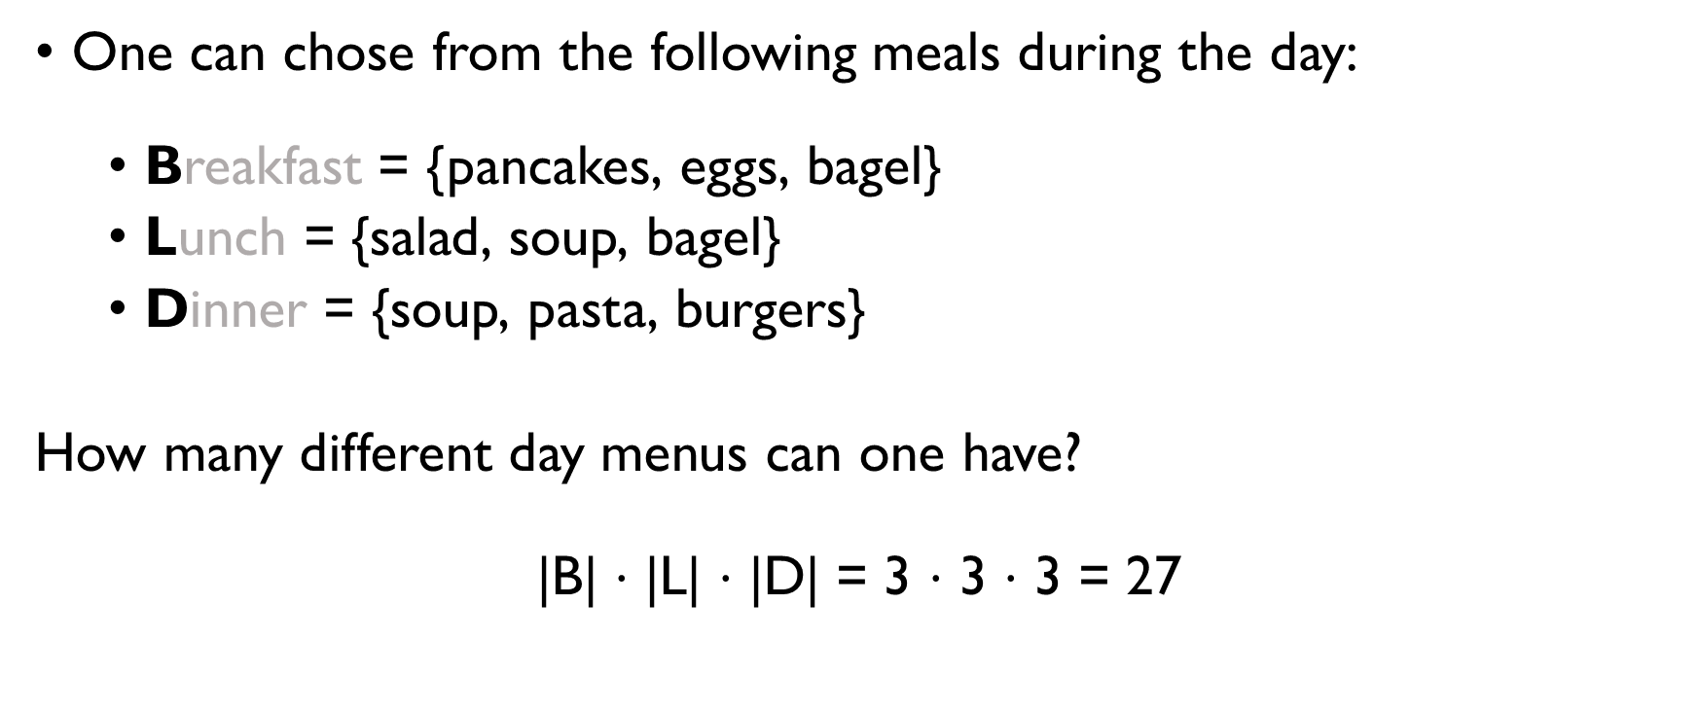
RULE OF PRODUCT: EXAMPLE 2
One can chose from the following meals during the day:
Breakfast = {pancakes, eggs, bagel}
Lunch = {salad, soup, bagel}
Dinner = {soup, pasta, burgers}
How many different day menus can one have?
|B| $⋅$ |L| $⋅$ |D| = 3 $⋅$ 3 $⋅$ 3 = 27

Slide 152
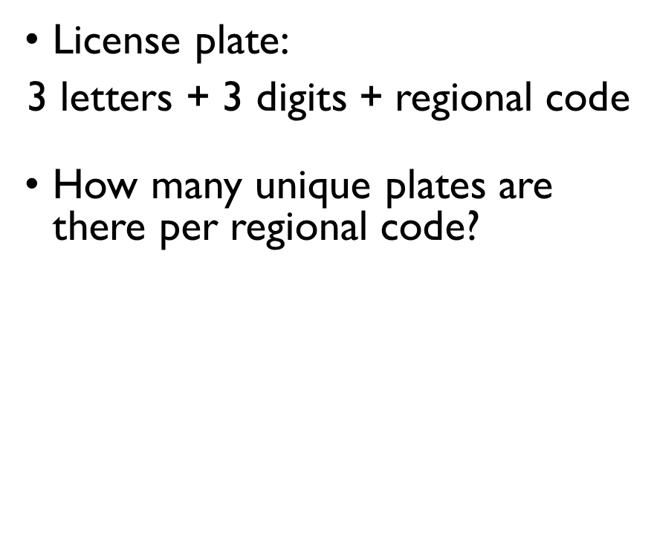
Rule of product: example 3
License plate:
3 letters + 3 digits + regional code
How many unique plates are there per regional code?
12 letters and 10 digits can be used:
12 $⋅$ 12 $⋅$ 12 $⋅$ 10 $⋅$ 10 $⋅$ 10 =
1 728 000

Slide 153
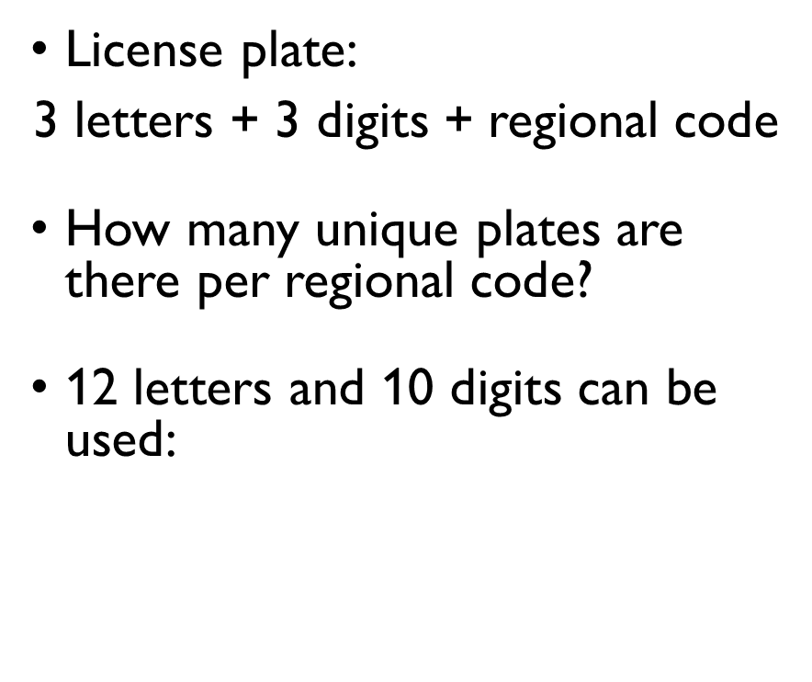
Rule of product: example 3
License plate:
3 letters + 3 digits + regional code
How many unique plates are there per regional code?
12 letters and 10 digits can be used:
12 $⋅$ 12 $⋅$ 12 $⋅$ 10 $⋅$ 10 $⋅$ 10 =
1 728 000

Slide 154
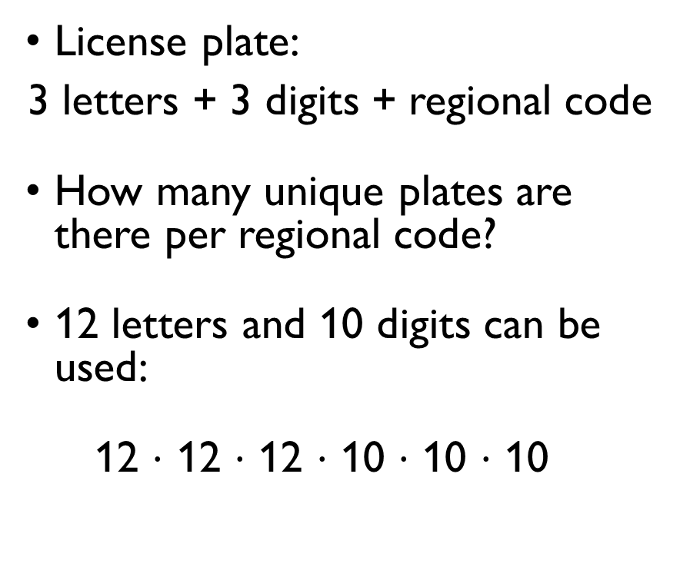
Rule of product: example 3
License plate:
3 letters + 3 digits + regional code
How many unique plates are there per regional code?
12 letters and 10 digits can be used:
12 $⋅$ 12 $⋅$ 12 $⋅$ 10 $⋅$ 10 $⋅$ 10 =
1 728 000

Slide 155
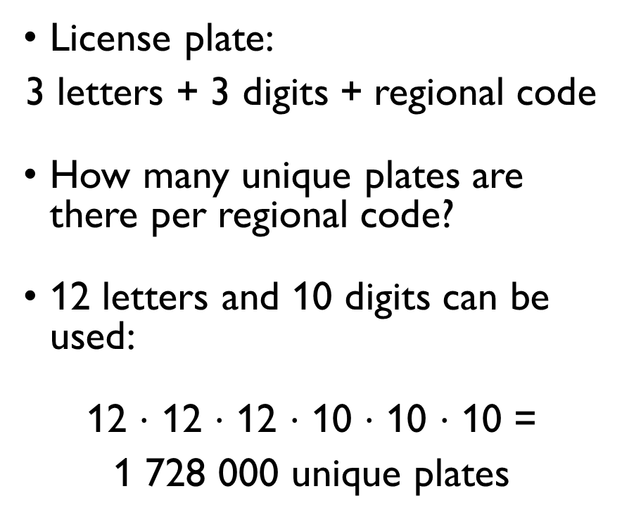
Rule of product: example 3
License plate:
3 letters + 3 digits + regional code
How many unique plates are there per regional code?
12 letters and 10 digits can be used:
12 $⋅$ 12 $⋅$ 12 $⋅$ 10 $⋅$ 10 $⋅$ 10 =
1 728 000 unique plates

Slide 156
MORE EXAMPLES
Sum and product rules in action

Slide 157
Sum & product rules in programming
RULE OF SUM
RULE OF PRODUCT
for i in range(n):
print(‘hello’)
for j in range(m):
print(‘hello’)
hello will be printed m + n times
for i in range(n):
for j in range(m):
print(‘hello’)
hello will be printed m*n times

Slide 158
Sum & product rules in programming
RULE OF SUM
RULE OF PRODUCT
for i in range(n):
print(‘hello’)
for j in range(m):
print(‘hello’)
hello will be printed m + n times
for i in range(n):
for j in range(m):
print(‘hello’)
hello will be printed m*n times

Slide 159
Sum & product rules in programming
RULE OF SUM
RULE OF PRODUCT
for i in range(n):
print(‘hello’)
for j in range(m):
print(‘hello’)
hello will be printed m + n times
for i in range(n):
for j in range(m):
print(‘hello’)
hello will be printed m*n times

Slide 160
Sum & product rules in programming
RULE OF SUM
RULE OF PRODUCT
for i in range(n):
print(‘hello’)
for j in range(m):
print(‘hello’)
hello will be printed m + n times
for i in range(n):
for j in range(m):
print(‘hello’)
hello will be printed m*n times

Slide 161
Sum & product rules in programming
RULE OF SUM
RULE OF PRODUCT
for i in range(n):
print(‘hello’)
for j in range(m):
print(‘hello’)
hello will be printed m + n times
for i in range(n):
for j in range(m):
print(‘hello’)
hello will be printed m*n times

Slide 162
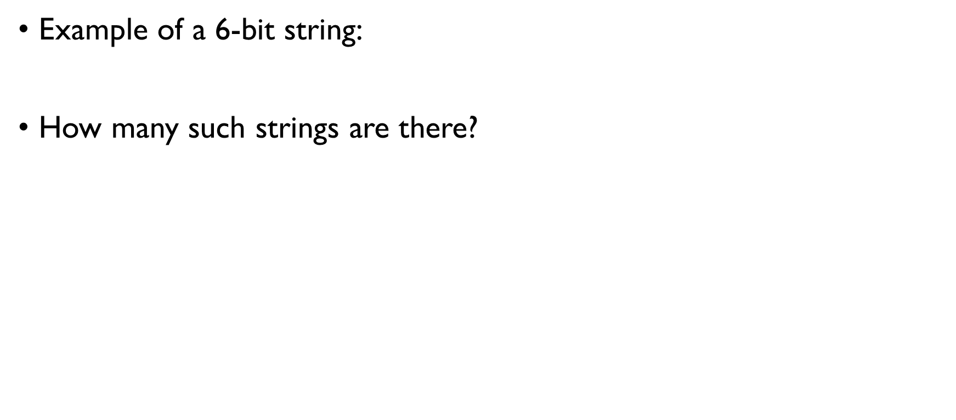
NUMBER OF 6-BIT STRINGS
Example of a 6-bit string:
How many such strings are there?
Solution: Each position: 0 or 1 (2 choices) Product rule:
2 $⋅$ 2 $⋅$ 2 $⋅$ 2 $⋅$ 2 $⋅$ 2 = 2⁶ = 64 different 6-bit strings.
0 | 1 | 1 | 1 | 0 | 1

Slide 163
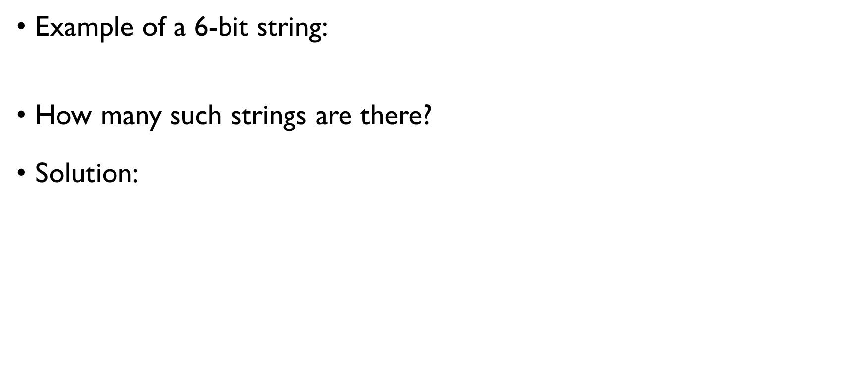
NUMBER OF 6-BIT STRINGS
Example of a 6-bit string:
How many such strings are there?
Solution: Each position: 0 or 1 (2 choices) Product rule:
2 $⋅$ 2 $⋅$ 2 $⋅$ 2 $⋅$ 2 $⋅$ 2 = 2⁶ = 64 different 6-bit strings.
0 | 1 | 1 | 1 | 0 | 1

Slide 164
NUMBER OF 6-BIT STRINGS
Example of a 6-bit string:
How many such strings are there?
Solution: Each position: 0 or 1 (2 choices) Product rule:
2 $⋅$ 2 $⋅$ 2 $⋅$ 2 $⋅$ 2 $⋅$ 2 = 2⁶ = 64 different 6-bit strings.
0 | 1 | 1 | 1 | 0 | 1
* | * | * | * | * | *

Slide 165
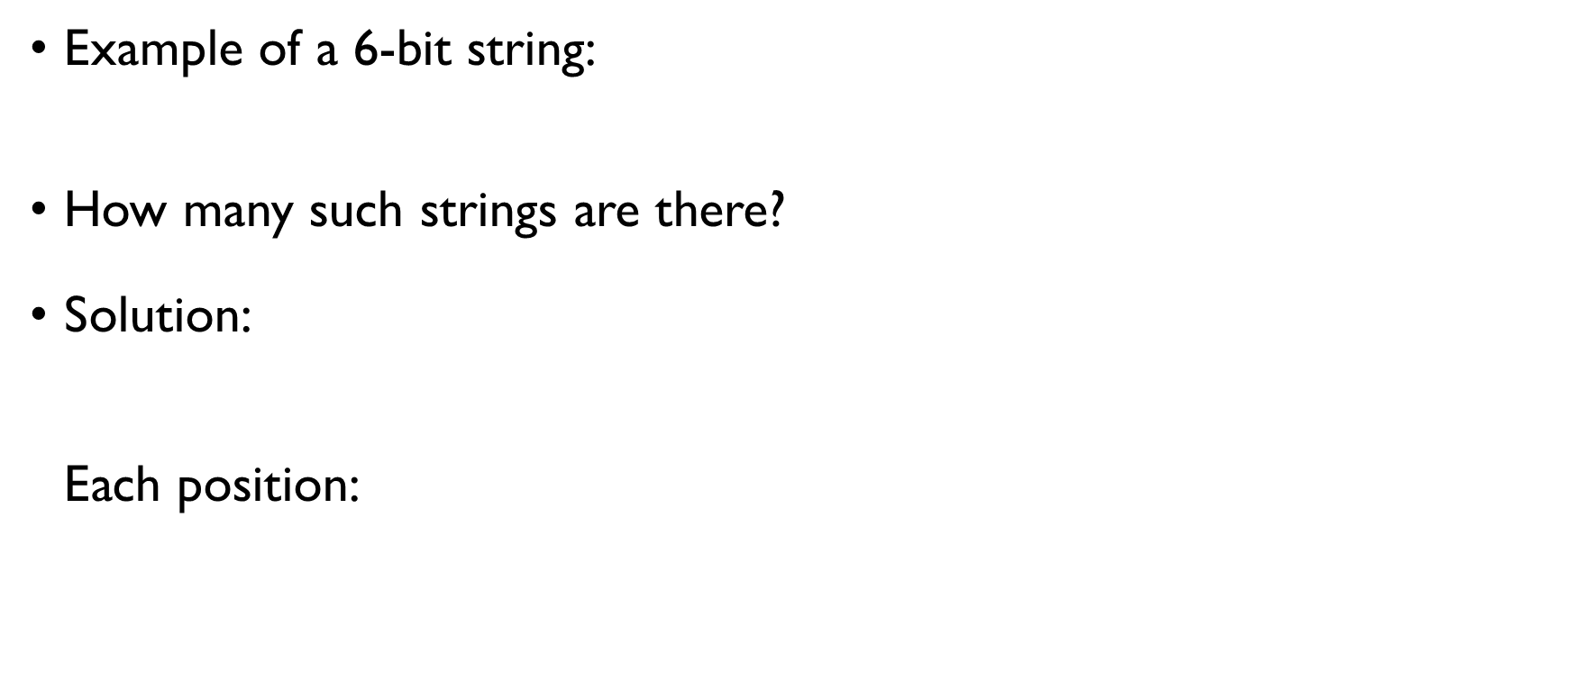
NUMBER OF 6-BIT STRINGS
Example of a 6-bit string:
How many such strings are there?
Solution: Each position: 0 or 1 (2 choices) Product rule:
2 $⋅$ 2 $⋅$ 2 $⋅$ 2 $⋅$ 2 $⋅$ 2 = 2⁶ = 64 different 6-bit strings.
0 | 1 | 1 | 1 | 0 | 1
* | * | * | * | * | *

Slide 166
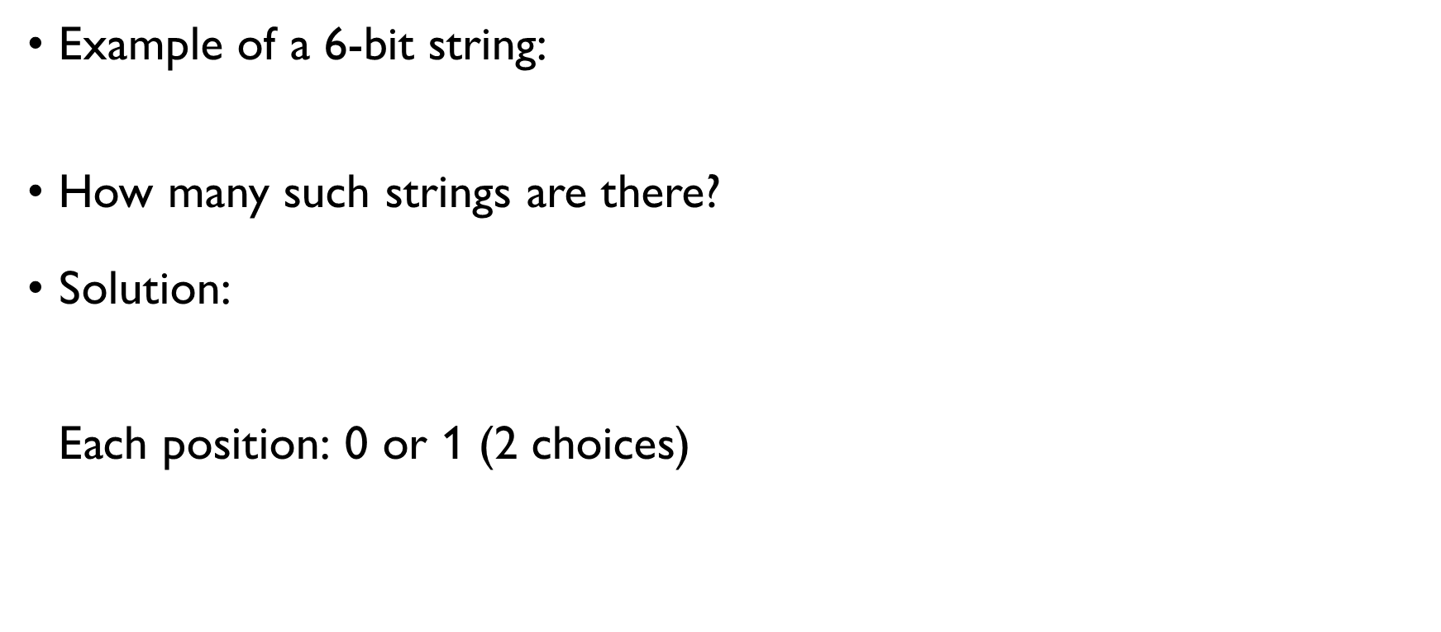
NUMBER OF 6-BIT STRINGS
Example of a 6-bit string:
How many such strings are there?
Solution: Each position: 0 or 1 (2 choices) Product rule:
2 $⋅$ 2 $⋅$ 2 $⋅$ 2 $⋅$ 2 $⋅$ 2 = 2⁶ = 64 different 6-bit strings.
0 | 1 | 1 | 1 | 0 | 1
* | * | * | * | * | *

Slide 167
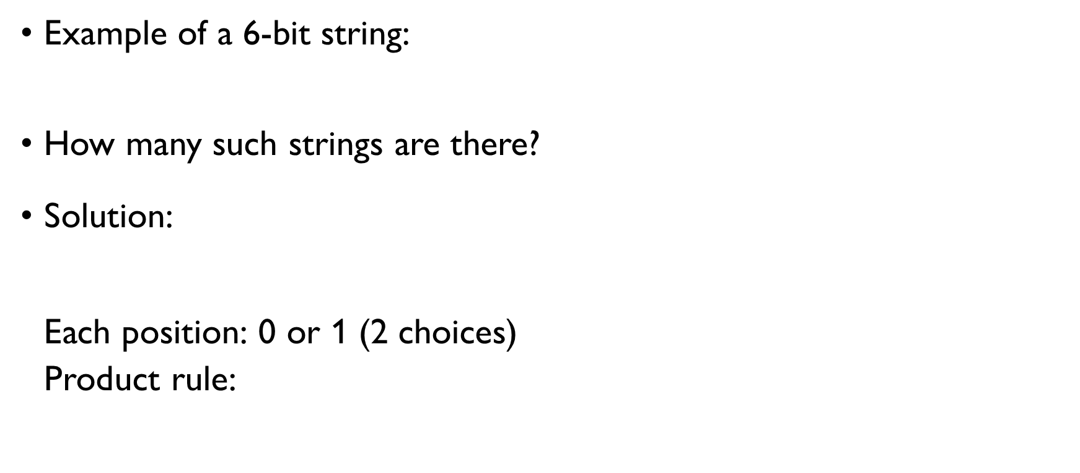
NUMBER OF 6-BIT STRINGS
Example of a 6-bit string:
How many such strings are there?
Solution: Each position: 0 or 1 (2 choices) Product rule:
2 $⋅$ 2 $⋅$ 2 $⋅$ 2 $⋅$ 2 $⋅$ 2 = 2⁶ = 64 different 6-bit strings.
0 | 1 | 1 | 1 | 0 | 1
* | * | * | * | * | *

Slide 168
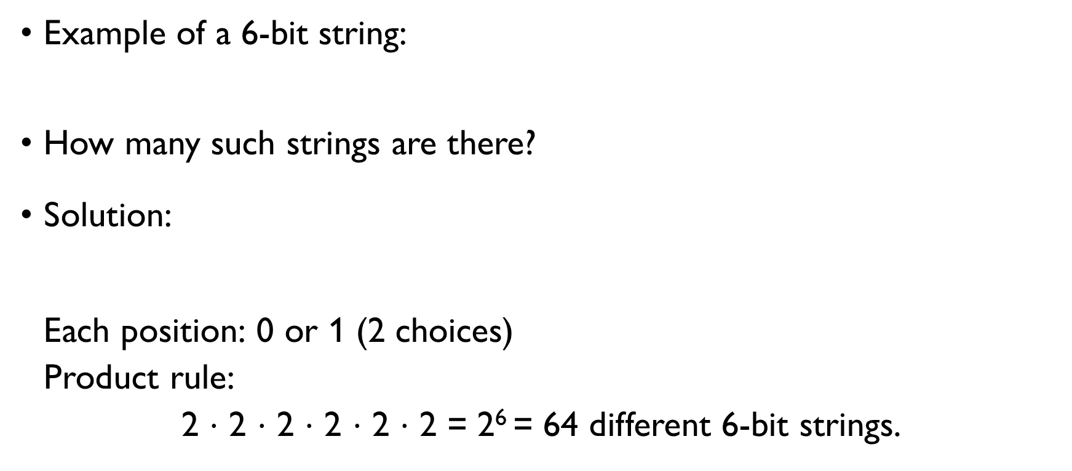
NUMBER OF 6-BIT STRINGS
Example of a 6-bit string:
How many such strings are there?
Solution: Each position: 0 or 1 (2 choices) Product rule:
2 $⋅$ 2 $⋅$ 2 $⋅$ 2 $⋅$ 2 $⋅$ 2 = 2⁶ = 64 different 6-bit strings.
0 | 1 | 1 | 1 | 0 | 1
* | * | * | * | * | *

Slide 169
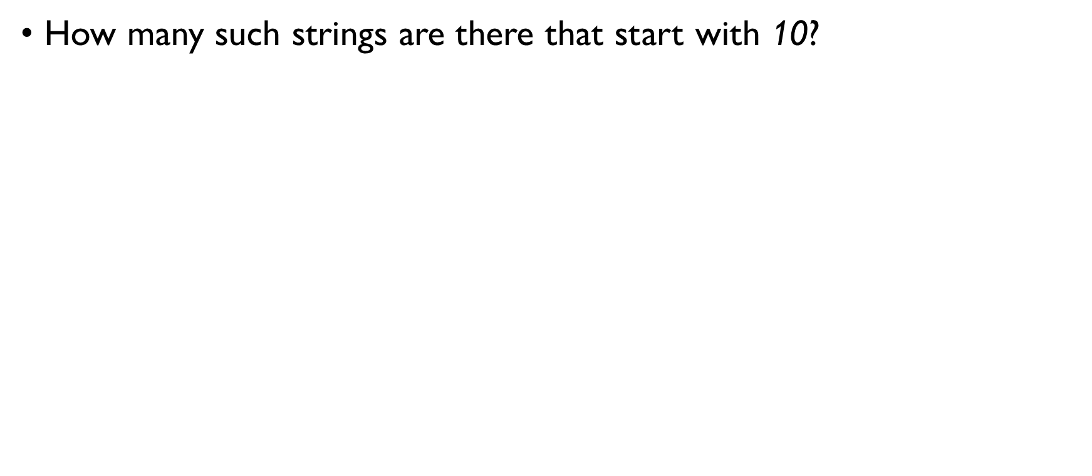
NUMBER OF 6-BIT STRINGS
How many such strings are there that start with 10?
Solution: Positions 1 & 2: 10 Other positions: 0 or 1 (2 choices) Product rule:
1 $⋅$ 1 $⋅$ 2 $⋅$ 2 $⋅$ 2 $⋅$ 2 = 2⁴ = 16 different 6-bit strings that start with 10.

Slide 170

NUMBER OF 6-BIT STRINGS
How many such strings are there that start with 10?
Solution: Positions 1 & 2: 10 Other positions: 0 or 1 (2 choices) Product rule:
1 $⋅$ 1 $⋅$ 2 $⋅$ 2 $⋅$ 2 $⋅$ 2 = 2⁴ = 16 different 6-bit strings that start with 10.
1 | 0 | * | * | * | *

Slide 171

NUMBER OF 6-BIT STRINGS
How many such strings are there that start with 10?
Solution: Positions 1 & 2: 10 Other positions: 0 or 1 (2 choices) Product rule:
1 $⋅$ 1 $⋅$ 2 $⋅$ 2 $⋅$ 2 $⋅$ 2 = 2⁴ = 16 different 6-bit strings that start with 10.
1 | 0 | * | * | * | *

Slide 172

NUMBER OF 6-BIT STRINGS
How many such strings are there that start with 10?
Solution: Positions 1 & 2: 10 Other positions: 0 or 1 (2 choices) Product rule:
1 $⋅$ 1 $⋅$ 2 $⋅$ 2 $⋅$ 2 $⋅$ 2 = 2⁴ = 16 different 6-bit strings that start with 10.
1 | 0 | * | * | * | *

Slide 173

NUMBER OF 6-BIT STRINGS
How many such strings are there that start with 10?
Solution: Positions 1 & 2: 10 Other positions: 0 or 1 (2 choices) Product rule:
1 $⋅$ 1 $⋅$ 2 $⋅$ 2 $⋅$ 2 $⋅$ 2 = 2⁴ = 16 different 6-bit strings that start with 10.
1 | 0 | * | * | * | *

Slide 174
NUMBER OF 6-BIT STRINGS
How many such strings are there that don’t start with 10?
Solution:
|strings that don’t start with 10| = |strings that start with 00| + |strings that start with 01| + + |strings that start with 11|
2⁴ + 2⁴ + 2⁴ = 16 + 16 + 16 = 48

Slide 175
NUMBER OF 6-BIT STRINGS
How many such strings are there that don’t start with 10?
Solution:
|strings that don’t start with 10| = |strings that start with 00| + |strings that start with 01| + + |strings that start with 11|
2⁴ + 2⁴ + 2⁴ = 16 + 16 + 16 = 48
not 10
* | * | * | * | * | *

Slide 176
NUMBER OF 6-BIT STRINGS
How many such strings are there that don’t start with 10?
Solution:
|strings that don’t start with 10| = |strings that start with 00| + |strings that start with 01| + + |strings that start with 11|
2⁴ + 2⁴ + 2⁴ = 16 + 16 + 16 = 48
not 10
* | * | * | * | * | *
SOLUTION 1

Slide 177
NUMBER OF 6-BIT STRINGS
How many such strings are there that don’t start with 10?
Solution:
|strings that don’t start with 10| = |strings that start with 00| + |strings that start with 01| + + |strings that start with 11|
2⁴ + 2⁴ + 2⁴ = 16 + 16 + 16 = 48
not 10
* | * | * | * | * | *
SOLUTION 1

Slide 178
NUMBER OF 6-BIT STRINGS
How many such strings are there that don’t start with 10?
Solution:
|strings that don’t start with 10| = |strings that start with 00| + |strings that start with 01| + + |strings that start with 11|
2⁴ + 2⁴ + 2⁴ = 16 + 16 + 16 = 48
not 10
* | * | * | * | * | *
SOLUTION 1

Slide 179
NUMBER OF 6-BIT STRINGS
How many such strings are there that don’t start with 10?
Solution:
|strings that don’t start with 10| = |all strings| - |strings that do start with 10|
2⁶ - 2⁴ = 64 – 16 = 48
not 10
* | * | * | * | * | *
SOLUTION 2

Slide 180
NUMBER OF 6-BIT STRINGS
How many such strings are there that don’t start with 10?
Solution:
|strings that don’t start with 10| = |all strings| - |strings that do start with 10|
2⁶ - 2⁴ = 64 – 16 = 48
not 10
* | * | * | * | * | *
SOLUTION 2

Slide 181
NUMBER OF 6-BIT STRINGS
How many such strings are there that don’t start with 10?
Solution:
|strings that don’t start with 10| = |all strings| - |strings that do start with 10|
2⁶ - 2⁴ = 64 – 16 = 48
not 10
* | * | * | * | * | *
SOLUTION 2

Slide 182
Number of bit strings of length 6 or less
How many bit strings are there of length 6 or less?
Solution:
Sum rule:
N = N₆ + N₅ + N₄ + N₃ + N₂ + N₁, N_{i} – # bit strings of length i
Product rule:
N_{i} = 2^{i}
N = 2⁶ + 2⁵ + 2⁴ + 2³ + 2² + 2¹ = 126

Slide 183
Number of bit strings of length 6 or less
How many bit strings are there of length 6 or less?
Solution:
Sum rule:
N = N₆ + N₅ + N₄ + N₃ + N₂ + N₁, N_{i} – # bit strings of length i
Product rule:
N_{i} = 2^{i}
N = 2⁶ + 2⁵ + 2⁴ + 2³ + 2² + 2¹ = 126

Slide 184
Number of bit strings of length 6 or less
How many bit strings are there of length 6 or less?
Solution:
Sum rule:
N = N₆ + N₅ + N₄ + N₃ + N₂ + N₁, N_{i} – # bit strings of length i
Product rule:
N_{i} = 2^{i}
N = 2⁶ + 2⁵ + 2⁴ + 2³ + 2² + 2¹ = 126

Slide 185
Number of bit strings of length 6 or less
How many bit strings are there of length 6 or less?
Solution:
Sum rule:
N = N₆ + N₅ + N₄ + N₃ + N₂ + N₁, N_{i} – # bit strings of length i
Product rule:
N_{i} = 2^{i}
N = 2⁶ + 2⁵ + 2⁴ + 2³ + 2² + 2¹ = 126

Slide 186
Number of bit strings of length 6 or less
How many bit strings are there of length 6 or less?
Solution:
Sum rule:
N = N₆ + N₅ + N₄ + N₃ + N₂ + N₁, N_{i} – # bit strings of length i
Product rule:
N_{i} = 2^{i}
N = 2⁶ + 2⁵ + 2⁴ + 2³ + 2² + 2¹ = 126

Slide 187
Number of bit strings of length 6 or less
How many bit strings are there of length 6 or less?
Solution:
Sum rule:
N = N₆ + N₅ + N₄ + N₃ + N₂ + N₁, N_{i} – # bit strings of length i
Product rule:
N_{i} = 2^{i}
N = 2⁶ + 2⁵ + 2⁴ + 2³ + 2² + 2¹ = 126

Slide 188
Subsets of a set
Consider a set {a, b, c}. How many subsets does it have? List them all.
0 elements:
{}
1 element:
{a} {b} {c}
2 elements:
{a, b} {a, c} {b, c}
3 elements:
{a, b, c}

Slide 189
Subsets of a set
Consider a set {a, b, c}. How many subsets does it have? List them all.
0 elements:
{}
1 element:
{a} {b} {c}
2 elements:
{a, b} {a, c} {b, c}
3 elements:
{a, b, c}

Slide 190
Subsets of a set
Consider a set {a, b, c}. How many subsets does it have? List them all.
0 elements:
{}
1 element:
{a} {b} {c}
2 elements:
{a, b} {a, c} {b, c}
3 elements:
{a, b, c}

Slide 191
Subsets of a set
Consider a set {a, b, c}. How many subsets does it have? List them all.
0 elements:
{}
1 element:
{a} {b} {c}
2 elements:
{a, b} {a, c} {b, c}
3 elements:
{a, b, c}

Slide 192
Subsets of a set
Consider a set {a, b, c}. How many subsets does it have? List them all.
0 elements:
{}
1 element:
{a} {b} {c}
2 elements:
{a, b} {a, c} {b, c}
3 elements:
{a, b, c}

Slide 193
Subsets of a set
Consider a set {a, b, c}. How many subsets does it have? List them all.
0 elements:
{}
1 element:
{a} {b} {c}
2 elements:
{a, b} {a, c} {b, c}
3 elements:
{a, b, c}

Slide 194

Number of subsets of a set
A 3-element set has 8 subsets.
How many subsets does a set of n elements have?
Solution: Each element can either be included in the subset (1) or not (0): 2 options per each of the n element (just like bit-strings!). Product rule: 2 $⋅$ 2 $⋅$ … $⋅$2 = 2^{n} subsets

Slide 195

Number of subsets of a set
A 3-element set has 8 subsets.
How many subsets does a set of n elements have?
Solution: Each element can either be included in the subset (1) or not (0): 2 options per each of the n element (just like bit-strings!). Product rule: 2 $⋅$ 2 $⋅$ … $⋅$2 = 2^{n} subsets

Slide 196

Number of subsets of a set
A 3-element set has 8 subsets.
How many subsets does a set of n elements have?
Solution: Each element can either be included in the subset (1) or not (0): 2 options per each of the n element (just like bit-strings!). Product rule: 2 $⋅$ 2 $⋅$ … $⋅$2 = 2^{n} subsets

Slide 197
Number of subsets of a set
A 3-element set has 8 subsets.
How many subsets does a set of n elements have?
Solution: Each element can either be included in the subset (1) or not (0): 2 options per each of the n element (just like bit-strings!). Product rule: 2 $⋅$ 2 $⋅$ … $⋅$2 = 2^{n} subsets
0 | 1 | 0 | … | 0 | 0 | 1

Slide 198

Number of subsets of a set
A 3-element set has 8 subsets.
How many subsets does a set of n elements have?
Solution: Each element can either be included in the subset (1) or not (0): 2 options per each of the n element (just like bit-strings!). Product rule: 2 $⋅$ 2 $⋅$ … $⋅$2 = 2^{n} subsets
0 | 1 | 0 | … | 0 | 0 | 1

Slide 199

Number of subsets of a set
A 3-element set has 8 subsets.
How many subsets does a set of n elements have?
Solution: Each element can either be included in the subset (1) or not (0): 2 options per each of the n element (just like bit-strings!). Product rule: 2 $⋅$ 2 $⋅$ … $⋅$2 = 2^{n} subsets
0 | 1 | 0 | … | 0 | 0 | 1

Slide 200

Number of subsets of a set
A 3-element set has 8 subsets.
How many subsets does a set of n elements have?
Solution: Each element can either be included in the subset (1) or not (0): 2 options per each of the n element (just like bit-strings!). Product rule: 2 $⋅$ 2 $⋅$ … $⋅$2 = 2^{n} subsets
0 | 1 | 0 | … | 0 | 0 | 1

Slide 201
Example: Number of passwords
A valid password contains 6 to 8 symbols
first symbol is a letter (upper- or lowercase);
other symbols are letters (upper- or lowercase) or digits.
How many different passwords are there?
Solution: Sum rule:
N = P₆ + P₇ + P₈ P_{i} – # passwords of length i

Slide 202
Example: Number of passwords
A valid password contains 6 to 8 symbols
first symbol is a letter (upper- or lowercase);
other symbols are letters (upper- or lowercase) or digits.
How many different passwords are there?
Solution: Sum rule:
N = P₆ + P₇ + P₈ P_{i} – # passwords of length i

Slide 203
Example: Number of passwords
A valid password contains 6 to 8 symbols
first symbol is a letter (upper- or lowercase);
other symbols are letters (upper- or lowercase) or digits.
How many different passwords are there?
Solution: Sum rule:
N = P₆ + P₇ + P₈ P_{i} – # passwords of length i

Slide 204
Example: Number of passwords
A valid password contains 6 to 8 symbols
first symbol is a letter (upper- or lowercase);
other symbols are letters (upper- or lowercase) or digits.
How many different passwords are there?
Solution: Sum rule:
N = P₆ + P₇ + P₈ P_{i} – # passwords of length i

Slide 205

Example: Number of passwords
Solution:
Sum rule: N = P₆ + P₇ + P₈ P_{i} – # passwords of length i
First symbol:
upper- or lowercase letter – 2 $⋅$ 26 = 52 options
Other symbols:
upper- or lowercase letter or digit – 52 + 10 = 62 options
Product rule: P₆ = 52 $⋅$ 62⁵ P₇ = 52 $⋅$ 62⁶ P₈ = 52 $⋅$ 62⁷
N = 52 $⋅$ 62⁵ + 52 $⋅$ 62⁶ +52 $⋅$ 62⁷

Slide 206

Example: Number of passwords
Solution:
Sum rule: N = P₆ + P₇ + P₈ P_{i} – # passwords of length i
First symbol:
upper- or lowercase letter – 2 $⋅$ 26 = 52 options
Other symbols:
upper- or lowercase letter or digit – 52 + 10 = 62 options
Product rule: P₆ = 52 $⋅$ 62⁵ P₇ = 52 $⋅$ 62⁶ P₈ = 52 $⋅$ 62⁷
N = 52 $⋅$ 62⁵ + 52 $⋅$ 62⁶ +52 $⋅$ 62⁷

Slide 207

Example: Number of passwords
Solution:
Sum rule: N = P₆ + P₇ + P₈ P_{i} – # passwords of length i
First symbol:
upper- or lowercase letter – 2 $⋅$ 26 = 52 options
Other symbols:
upper- or lowercase letter or digit – 52 + 10 = 62 options
Product rule: P₆ = 52 $⋅$ 62⁵ P₇ = 52 $⋅$ 62⁶ P₈ = 52 $⋅$ 62⁷
N = 52 $⋅$ 62⁵ + 52 $⋅$ 62⁶ +52 $⋅$ 62⁷

Slide 208

Example: Number of passwords
Solution:
Sum rule: N = P₆ + P₇ + P₈ P_{i} – # passwords of length i
First symbol:
upper- or lowercase letter – 2 $⋅$ 26 = 52 options
Other symbols:
upper- or lowercase letter or digit – 52 + 10 = 62 options
Product rule: P₆ = 52 $⋅$ 62⁵ P₇ = 52 $⋅$ 62⁶ P₈ = 52 $⋅$ 62⁷
N = 52 $⋅$ 62⁵ + 52 $⋅$ 62⁶ +52 $⋅$ 62⁷

Slide 209

Example: Number of passwords
Solution:
Sum rule: N = P₆ + P₇ + P₈ P_{i} – # passwords of length i
First symbol:
upper- or lowercase letter – 2 $⋅$ 26 = 52 options
Other symbols:
upper- or lowercase letter or digit – 52 + 10 = 62 options
Product rule: P₆ = 52 $⋅$ 62⁵ P₇ = 52 $⋅$ 62⁶ P₈ = 52 $⋅$ 62⁷
N = 52 $⋅$ 62⁵ + 52 $⋅$ 62⁶ +52 $⋅$ 62⁷

Slide 210

Example: Number of passwords
Solution:
Sum rule: N = P₆ + P₇ + P₈ P_{i} – # passwords of length i
First symbol:
upper- or lowercase letter – 2 $⋅$ 26 = 52 options
Other symbols:
upper- or lowercase letter or digit – 52 + 10 = 62 options
Product rule: P₆ = 52 $⋅$ 62⁵ P₇ = 52 $⋅$ 62⁶ P₈ = 52 $⋅$ 62⁷
N = 52 $⋅$ 62⁵ + 52 $⋅$ 62⁶ +52 $⋅$ 62⁷

Slide 211

Example: Number of passwords
Solution:
Sum rule: N = P₆ + P₇ + P₈ P_{i} – # passwords of length i
First symbol:
upper- or lowercase letter – 2 $⋅$ 26 = 52 options
Other symbols:
upper- or lowercase letter or digit – 52 + 10 = 62 options
Product rule: P₆ = 52 $⋅$ 62⁵ P₇ = 52 $⋅$ 62⁶ P₈ = 52 $⋅$ 62⁷
N = 52 $⋅$ 62⁵ + 52 $⋅$ 62⁶ +52 $⋅$ 62⁷

Slide 212

Example: Number of passwords
Solution:
Sum rule: N = P₆ + P₇ + P₈ P_{i} – # passwords of length i
First symbol:
upper- or lowercase letter – 2 $⋅$ 26 = 52 options
Other symbols:
upper- or lowercase letter or digit – 52 + 10 = 62 options
Product rule: P₆ = 52 $⋅$ 62⁵ P₇ = 52 $⋅$ 62⁶ P₈ = 52 $⋅$ 62⁷
N = 52 $⋅$ 62⁵ + 52 $⋅$ 62⁶ +52 $⋅$ 62⁷

Slide 213

Example: Number of passwords
Solution:
Sum rule: N = P₆ + P₇ + P₈ P_{i} – # passwords of length i
First symbol:
upper- or lowercase letter – 2 $⋅$ 26 = 52 options
Other symbols:
upper- or lowercase letter or digit – 52 + 10 = 62 options
Product rule: P₆ = 52 $⋅$ 62⁵ P₇ = 52 $⋅$ 62⁶ P₈ = 52 $⋅$ 62⁷
N = 52 $⋅$ 62⁵ + 52 $⋅$ 62⁶ +52 $⋅$ 62⁷

Slide 214
OTHER USEFUL TRICKS

Slide 215
COUNTING ONE THING BY COUNTING ANOTHER
How to count the number of people in the class?
Count heads
Count their laptops
Count ears and divide by 2 ☺
(assuming that everyone has exactly two ears)

Slide 216
COUNTING ONE THING BY COUNTING ANOTHER
How to count the number of people in the class?
Count heads
Count their laptops
Count ears and divide by 2 ☺
(assuming that everyone has exactly two ears)

Slide 217
COUNTING ONE THING BY COUNTING ANOTHER
How to count the number of people in the class?
Count heads
Count their laptops
Count ears and divide by 2 ☺
(assuming that everyone has exactly two ears)

Slide 218

COUNTING ONE THING BY COUNTING ANOTHER
How to count the number of people in the class?
Count heads
Count their laptops
Count ears and divide by 2 ☺
(assuming that everyone has exactly two ears)

Slide 219


NUMBER OF HANDSHAKES
There are $n$ people in a room. Everyone shakes hands with everyone. How many handshakes are there?
Solution: Every person (n) shakes hands with everyone else:
We counted each handshake twice! Fixing it: $\frac{n\left(n−1\right)}{2}$
$n\left(n−1\right)$ handshakes?

Slide 220

NUMBER OF HANDSHAKES
There are $n$ people in a room. Everyone shakes hands with everyone. How many handshakes are there?
Solution: Every person (n) shakes hands with everyone else:
We counted each handshake twice! Fixing it: $\frac{n\left(n−1\right)}{2}$
$n\left(n−1\right)$ handshakes?

Slide 221

NUMBER OF HANDSHAKES
There are $n$ people in a room. Everyone shakes hands with everyone. How many handshakes are there?
Solution: Every person (n) shakes hands with everyone else:
We counted each handshake twice! Fixing it: $\frac{n\left(n−1\right)}{2}$
$n\left(n−1\right)$ handshakes?

Slide 222


NUMBER OF HANDSHAKES
There are $n$ people in a room. Everyone shakes hands with everyone. How many handshakes are there?
Solution: Every person (n) shakes hands with everyone else (n-1):
We counted each handshake twice! Fixing it: $\frac{n\left(n−1\right)}{2}$
$n\left(n−1\right)$ handshakes?

Slide 223

NUMBER OF HANDSHAKES
There are $n$ people in a room. Everyone shakes hands with everyone. How many handshakes are there?
Solution: Every person (n) shakes hands with everyone else (n-1):
We counted each handshake twice! Fixing it: $\frac{n\left(n−1\right)}{2}$
$n\left(n−1\right)$ handshakes?

Slide 224

NUMBER OF HANDSHAKES
There are $n$ people in a room. Everyone shakes hands with everyone. How many handshakes are there?
Solution: Every person (n) shakes hands with everyone else (n-1):
We counted each handshake twice! Fixing it: $\frac{n\left(n−1\right)}{2}$
$n\left(n−1\right)$ handshakes?

Slide 225

NUMBER OF HANDSHAKES
There are $n$ people in a room. Everyone shakes hands with everyone. How many handshakes are there?
Solution: Every person (n) shakes hands with everyone else (n-1):
We counted each handshake twice! Fixing it: $\frac{n\left(n−1\right)}{2}$
$n\left(n−1\right)$ handshakes?

Slide 226
LET’S PRACTICE
https://docs.google.com/document/d/1XM0qoghJNkjnrVL3QVb_cSYRnfz1qdf7CLK6yFezF18/edit?usp=sharing

Slide 227
To sum up
The basics of set theory.
Basic counting principles:
sum rule;
product rule;
combining the rules.
Other tricks
using complement of a set;
overcounting.

